Slide 1
Clery Act
UUP/Campus Security Authority Training
Dawn Smallwood
Chief of Police
Assistant VP for Campus Safety

Slide 2
The Jeanne Clery Campus Security Policy and Crime Statistics Disclosure Act
Federal statue (20 USC 1092(f)) requires all colleges and universities that participate in Federal Title IV student financial aid programs to disclose campus crime statistics and security information.
Compliance with the Clery Act falls under the mandate of the US Department of Education.

Slide 3
What is the Clery Act?
Jeanne Clery was raped and murdered while asleep in her dorm room at Lehigh University in 1986. She was murdered by another student who had entered her dorm through three propped doors.
Her parents discovered that there had been numerous reports of propped doors and there had been 38 violent crimes in the three years prior to her murder at Lehigh. Her parents believed Jeanne would have been more cautious if she had known about the other violent crimes at Lehigh.
The law enacted in her memory is intended to ensure that students and other campus community members are informed about campus crime so they can make informed decisions.

Slide 4
What Does Clery Require?
Institutions must:
Collect, classify and count crime reports and submit statistics to the US Department of Education.
Provide emergency notification and evacuation procedures.
Issue a timely warning for any Clery Act crime that represents an ongoing threat to the safety of students or employees. (May issue a timely warning to non-Clery crimes)
Issue an emergency notification upon the confirmation of a significant emergency or dangerous situation involving an immediate threat to the health or safety of students or employees occurring on the campus.

Slide 5
What Does Clery Require?
Publish an annual security report and fire safety report
(by Oct 1 of each year) containing required safety and security-related policy statements and crime statistics for the previous three calendar years and distribute it or advise where to locate it electronically to all current students and employees. Schools also must inform prospective students and employees about the availability of the report.
  Inform the campus community where to obtain information about registered sex offenders
  Create, maintain and make available a crime log and fire log.

Slide 6
The Department of Education recognizes students may be more inclined to report crimes to someone other than the campus police.
For this reason, the Clery Act requires all institutions to collect crime reports from a variety of individuals and organizations that Clery considers to be "campus security authorities.”
Data is collected from a wide variety of “campus security authorities” to provide the most accurate crime statistics possible.

Slide 7
Records Collection and Retention
University Police must:
-Keep records of crimes reported to campus security authorities
-Make efforts to obtain certain crime statistics from other law enforcement agencies
-Keep a daily crime log open for public inspection
-Keep campus records & request records from other law enforcement agencies

Slide 8
Campus Security Authorities
Officials of the institution with significant responsibility for student and campus activities (Vice Presidents, Deans, Directors, etc.), including but not limited to the areas of:
Student Affairs
Dean of Students
Ombudsperson
Multicultural Student Services
University Life
Residence Life (to include RA’s/RHD’s/QD’s)
Community Standards
Title IX Coordinator
Police/Security
Academic Advisement
Career Services
Continuing Education
Financial Aid
Instructional Support
Disability Services
Orientation
Administrators who oversee branch campuses
Athletic directors, coaches and assistant coaches
Human Resources/Labor Relations
Faculty or staff advisors to student organizations or those that serve as formal or unofficial mentors to students
Office of Equity and Access

Slide 9
Who is NOT a Campus Security Authority?
You may have significant responsibility for Student and Campus Activities but YOU DO NOT HAVE TO REPORT IF:
You are a licensed mental health counselor or a pastoral counselor (employed by a religious organization to provide confidential counseling) AND You are working within the scope of your license or religious assignment
Student Health Center Clinicians who only provide care to individual students
Counselors in the Counseling Center who only provide care to individual students

Slide 10
Campus Security Authority’s Primary Responsibility is…
“To report allegations made in good faith to the reporting structure established by the institution.”
In “good faith” means there is a reasonable basis for believing that the information is not simply rumor or hearsay. That is, there is little or no reason to doubt the validity of the information.
If a campus security authority observes a crime/violation or receives the crime information and believes it was provided in good faith, he or she should document it by reporting to the University Police (2-3333), Student Conduct and Community Standards (2-6705), or Title lX (2-6280) as soon a practicable.
What you must disclose, therefore, are statistics from reports of alleged criminal incidents. It is not necessary for the crime to have been investigated by the police or campus security authority, nor must a finding of guilt or responsibility be made to disclose the statistic.

Slide 11
In Your Role as a CSA, Please Remember
To inform the University Police Department, Student Conduct and Community Standards or the Title lX office as soon as practicable about Clery reportable crimes or violations.
University Police will make the final crime classification determination
If in doubt or unsure, report it to the police 631-632-3333 or
2-3333 from any campus phone

Slide 12
What Crimes Must I Report?
Criminal homicide – Murder/Non-negligent Manslaughter, Negligent
Manslaughter
Sex Offenses – Rape, Fondling, Statutory Rape, and Incest
Robbery
Aggravated assault
Burglary
Motor vehicle theft
Arson
Hate crimes- Any Clery reportable offenses and any incidents of Larceny-Theft, Simple Assault, Intimidation, or Destruction, Damage, or Vandalism of Property that were motivated by bias based on race, religion, sexual orientation, gender, gender identity, ethnicity, nation origin or disability.
Arrests & disciplinary referrals for violations of liquor, drug, & weapons laws
Dating Violence, Domestic Violence, Stalking (New Additions)

Slide 13
Dating Violence
Dating Violence – The term “dating violence” means violence committed by a person
  who is or has been in a social relationship of a romantic or intimate nature with the victim;
  where the existence of such a relationship shall be determined based on a consideration of the following factors:
    The length of the relationship
    The type of relationship
    The frequency of interaction between the persons involved in the relationship

Slide 14
Domestic Violence
Domestic Violence -The term “domestic violence” includes crimes of violence committed by
  a current or former spouse of the victim, by a person with whom the victim shares a child in common, by a person who is cohabitating with or has cohabitated with the victim as a spouse, by a person similarly situated to a spouse of the victim under the domestic or family violence laws of the jurisdiction, or by any other person against an adult or youth victim who is protected from that person’s acts under the domestic or family violence laws of the jurisdiction.

Slide 15
Stalking
Stalking – The term “stalking’ means engaging in a course of conduct directed at a specific person that would cause a reasonable person to
  fear for his or her safety or the safety of others; or
  suffer substantial emotional distress.

Slide 16
Liquor, Drug, Weapon Law Violations
Police must keep statistics on the number of people arrested for liquor, drug and weapon law violations.
Residence Life and University Community Standards keep statistics on the number of people referred for disciplinary action for liquor, drug and weapon law violations.
Statistics must reflect the total number of persons involved, not incidents.

Slide 17
Where Did it Happen?
A crime must be reported if it occurred:
  On campus main and satellite (i.e. Southampton, Manhattan, SUNY Korea)
  Non-campus building or property (i.e. Tech Park, Calverton)
  Public property on/or immediately adjacent to campus and easily accessible from campus (i.e. 25A, Nicholls Road)

Slide 18
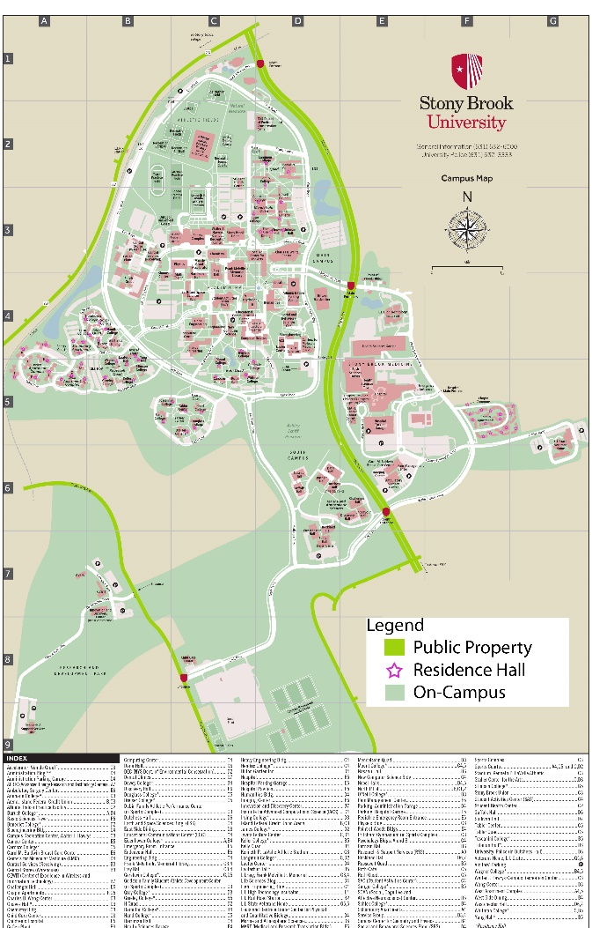
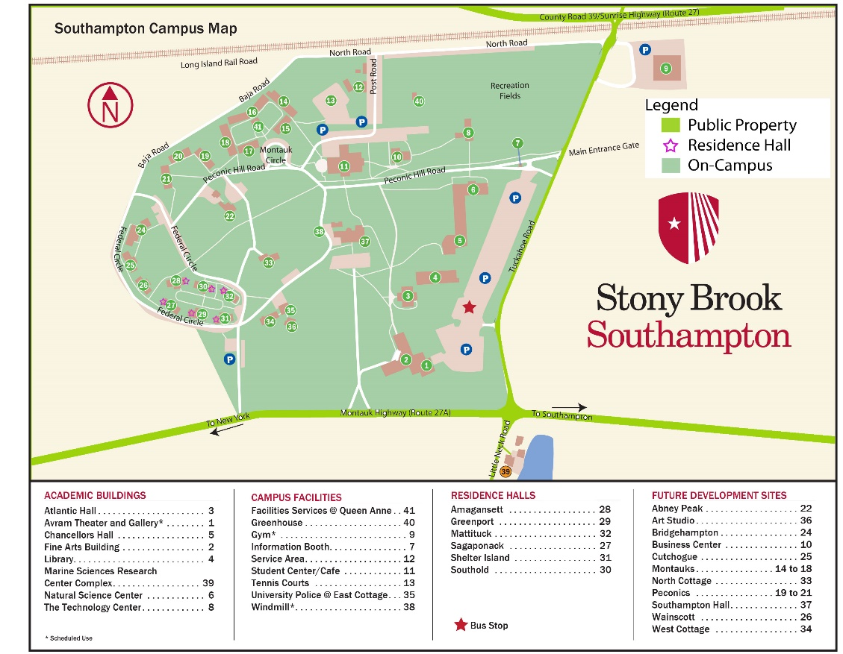
Stony Brook Clery Geography

Slide 19
What is “On Campus”?
Owned or controlled by the institution within the same reasonably contiguous geographic area and used to meet or support the institutions educational purposes
  Residence Halls (also a subset category)
  Administrative Buildings
  Academic Buildings
  Food and Retail Vendors

Slide 20
What is “Non-campus”?
Any building or property not part of the main campus nor a satellite campus and is:
  Owned or controlled by the institution
  Used in support or in relation to the institution’s educational purposes
  Frequently used by students
  Not within the same reasonably contiguous geographic area of the institution
  Owned or controlled by a student organization that is officially recognized by the institution
  Non-Campus includes: Study Abroad Programs, Extended Educational Programs where travel is required and extended Athletic Events where housing is not provided by the hosting school

Slide 21
What is “Public Property”?
All public property that is within the campus, or immediately adjacent to and accessible from the campus
  Thoroughfares
  Streets
  Sidewalks
  Public parking facilities
  Private homes and businesses are not included

Slide 22
Three Part Test
Is the crime a Clery reportable crime?
Did the crime occur in a Clery reportable geographic area?
Was the crime previously reported to University Police?
If you answered YES to Question #1 and #2 and NO to Question #3, then you must notify University Police about the incident.

Slide 23
Examples of Reportable Crimes
A coach is required to report a sexual assault that is reported to them…
A person working as an access monitor is required to report a burglary that is reported to them while working the desk…
An RA is told by a student that she was forcibly raped by an unidentified person while jogging along a campus trail…
The Director of Athletics is required to report a rape that was reported to them by the parent of a victim involving one of their athletes who may be the perpetrator…
A professor is required to report that a student reported to them that they were being physically abused by their intimate dating partner

Slide 24
Rights of Reporting Individual
“You have the right to make a report to university police or campus security, local law enforcement, and/or state police or choose not to report;
To report the incident to you institution;
To be protected by the institution from retaliation for reporting an incident; and,
To receive assistance and resources from your institution.”
                NY Education Law, Section 6444(2)

Slide 25
Confidentiality vs. Privacy
“Confidentiality” may be offered by an individual who is not required by law to report known incidents of sexual assault or other crimes to institution officials, in a manner consistent with state and federal law, including but not limited to 20 U.S.C. 1092(f) and 20 U.S.C. 1681(a). Licensed mental health counselors, medical providers and pastoral counselors are examples of institution employees who may offer confidentiality.
“Privacy” may be offered by an individual when such individual is unable to offer confidentiality under the law but shall still not disclose information learned from a reporting individual or bystander to a crime or incident more than necessary to comply with this and other applicable laws, including informing appropriate institution officials.
N.Y. Educ. Law § 6439

Slide 26
Confidentiality vs. Privacy
Only UUP Members with a legal privilege and who maintain that privilege in their specific role can maintain true “confidentiality”
All other Members may offer “privacy,” but may not promise confidentiality to reporting individuals
When communicating with a reporting individual, UUP Members who ordinarily have a legal privilege (e.g., attorney-client) may be unable to maintain the privilege when acting in their official university role

Slide 27
Retaliation
Retaliation is prohibited against any participant in the reporting process
Retaliation is prohibited against a UUP Member for reporting a crime or violation
Failure to properly report a covered incident may result in discipline

Slide 28
Reporting
In an emergency dial 911.
This will reach University Police from any campus phone and local police from any non-campus phone.
University Police……..…………………..631-632-3333
Title IX Coordinator……...................631-632-6280
Office of Student Conduct and Community Standards…………………………………….631-632-6705
Employee and Labor Relations East Campus……………………………………….631-632-6140
Employee and Labor Relations Stony Brook Hospital…………...............................631-444-3780
Employee and Labor Relations L.I. State Veterans Home……………………………631-444-8617
NYS Police 24-Hour Campus Sexual Assault Hotline……...……...........................1-844-845-7269
Resources
Survivor Advocate………………………..631-647-9981
Center for Prevention and Outreach (CPO)……………………………………………631-632-2748
Counseling and Psychological Services (CAPS)…………………………………………..631-632-6720
Interfaith Center: http://www.sbinterfaith.org/
SAFE Center (Sexual Assault Forensic Examination…………………………………631-444-2465
Student Health Services………………631-632-6710
NYS Office of Victims Services (OVS)
………………………………....................1-800-247-6035
VIBS (Victim Information Bureau of Suffolk………………………………………….631-360-3606
SUNY Sexual Assault and Violence Response (SAVR):
https://www.suny.edu/violence-response/
Additional Community Based Resources:
https://www.stonybrook.edu/commcms/oea-titleix/resources/

Slide 29
Possible University Sanctions for Noncompliance
A suspension or limiting of the institution’s Title IV funding.
The Department of Education can issue civil fines up to $59,017 per violation.
Final Review Determination Reports are public record.
Failure to comply with the Clery Act can be used in court to demonstrate an indifference to security issues during a premises security liability litigation.

Slide 30
Questions
Any questions regarding the content of this power point presentation can be directed to:
campus_csa@stonybrook.edu
All other inquiries can be directed to:
Hrs_info@stonybrook.edu

