Slide 1
Listening to the Campus Pulse:
Lessons Learned from Two Years of Administering a Pulse Survey
Braden J. Hosch, Vice President
Division of Educational and Institutional Effectiveness
May 7, 2024

Slide 2
Overview
Net promoter score approach
Results / Analysis
Dissemination
Lessons Learned

Slide 3
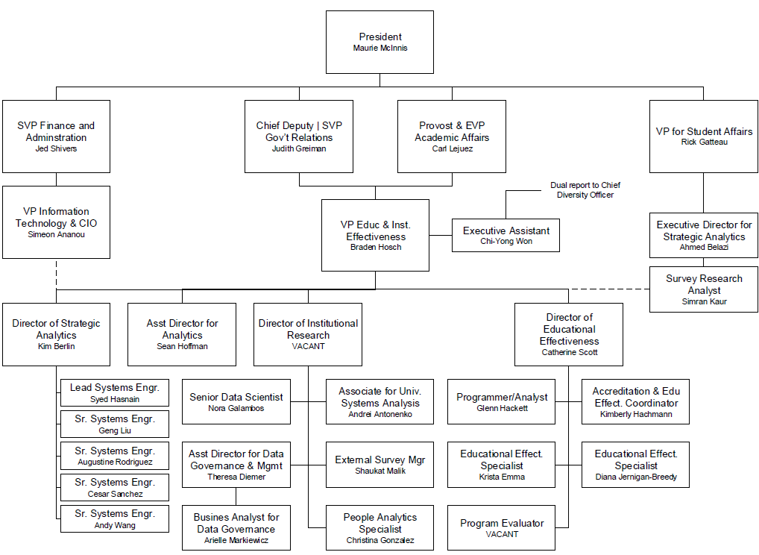
Organization Chart
Division of Educational & Institutional Effectiveness

Slide 4
Problems with Higher Ed Survey Research
Cross-sectional survey research is too slow
Cycle time is too long
Lengthy instruments
Declining response rates
High burden for analysis

Slide 5
Solution: Administer a Weekly Pulse Survey
Pulse survey
One question + follow up
Administered weekly
Results distributed via email and dashboard
B

Slide 6
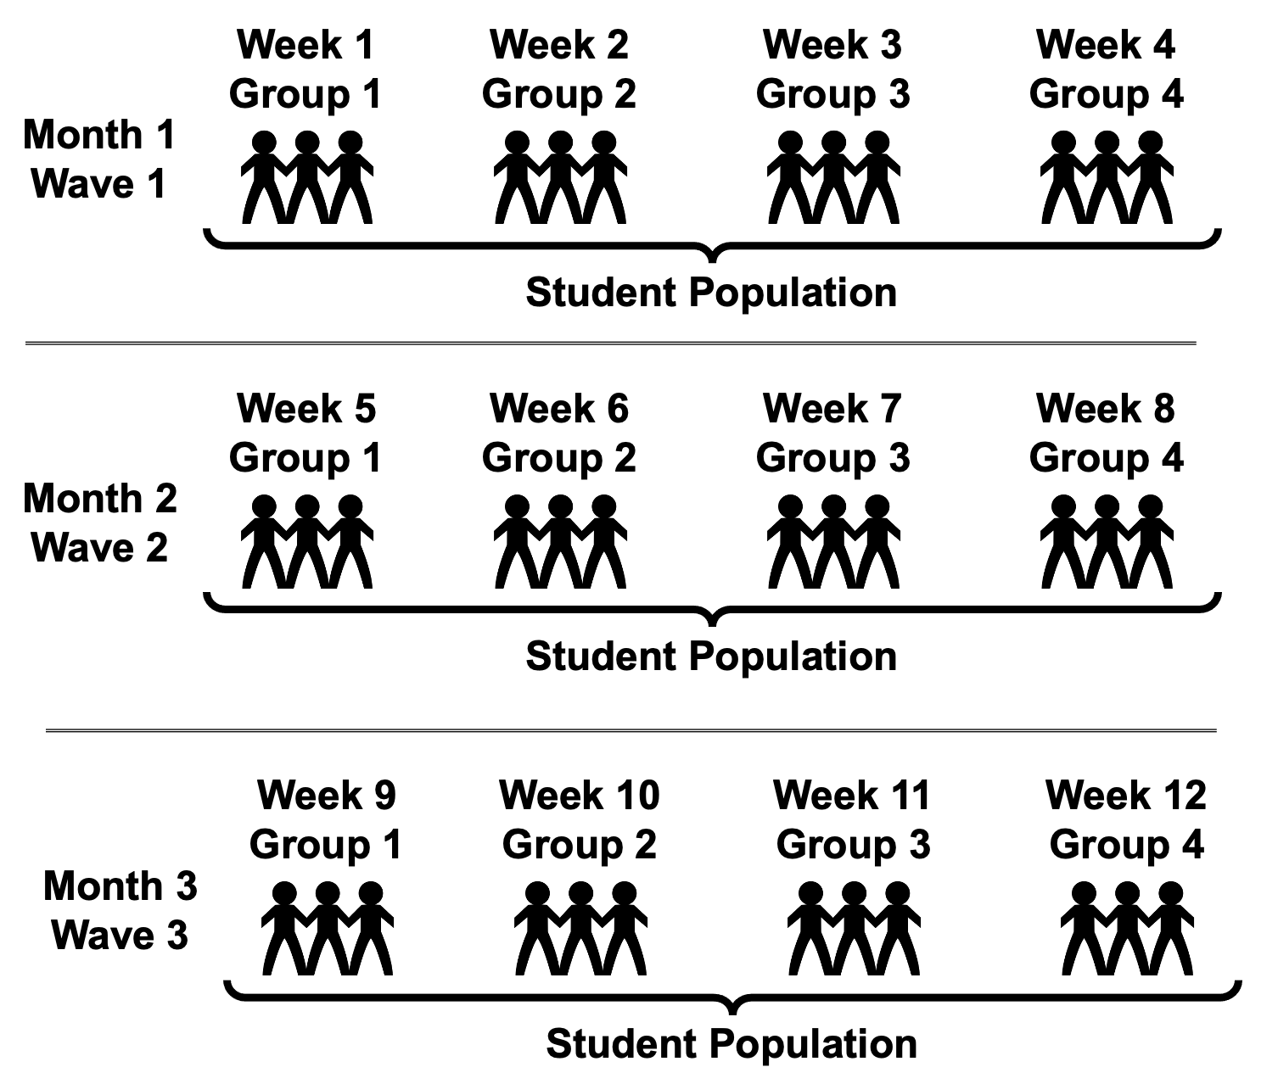
Administration
Approach
Confidential but not anonymous.
Response data linked to PII in institutional data systems
Academic Semester
About 6,000 subjects per group

Slide 7
Net Promoter Score (NPS)
Detractors -- They are not particularly thrilled by you. They, with all likelihood, won’t choose to engage with you again, and could potentially damage your reputation through negative word of mouth.
Passives -- They are somewhat satisfied but could easily switch to a competitor’s offering if given the opportunity. They probably wouldn’t spread any negative word-of-mouth, but are not enthusiastic enough to actually promote you.
Promoters -- They love you. They are your repeat customers. They are enthusiastically evangelical about you and recommend you to others.
Reicheld, F. (2003). “The one number you need to grow,” Harvard Business Review.

Slide 8
Email on Tuesday (+ reminder on Thursday)
Dear Ahmed,
We want your feedback! Using the Campus Pulse Survey, our goal is to listen and understand more about your current experiences at Stony Brook University. Your feedback will help us improve our services and your experience. Your participation is voluntary and the survey is only one question (with an option to share additional feedback as a comment).
You can participate by responding to the question below:
Or to respond via your web browser, you can click here or copy and paste the following URL into your browser:
https://stonybrookuniversity.co1.qualtrics.com/jfe/form/SV_2iy3WVHFwajp3im?Q_DL=QKNIpR5uiezXFpw_2iy3WVHFwajp3im_CGC_I0rwwd8SAedJiPE&Q_CHL=email
We know you have a lot going on so as a thank you for your participation, any student who participates will be entered into a monthly raffle for some awesome SBU swag pictured below!

Slide 9
Incentives
Participants who complete the survey...
...before 11:59 pm this Thursday 5/25 will receive 10 raffle entries
...before 11:59 pm this Saturday 5/27 will receive 5 raffle entries
...before 11:59 pm on Monday 5/29 will receive 2 raffle entries
...after 11:59 pm on Monday 5/29 will receive 1 raffle entry
Overall, your participation should take no longer than 2 minutes and you can choose to leave any question unanswered.
We truly appreciate your time and thank you in advance!
To verify the authenticity of this survey, you may visit:
www.stonybrook.edu/isthissurveyreal
Best,
Rick Gatteau, PhD
Vice President for Student Affairs
and more!

Slide 10
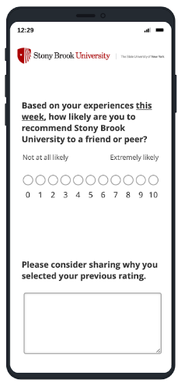
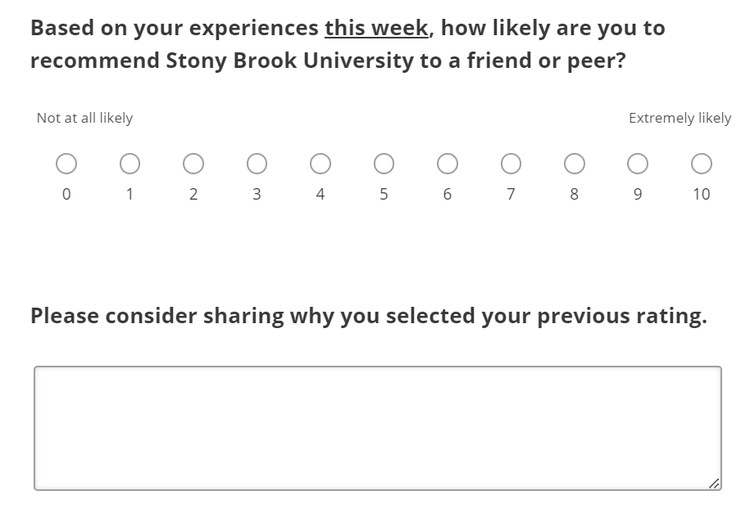
Instrument in Qualtrics

Slide 11
Response Rates
 | 2023 | 2024 | Total
Total Responses | 11,034 | 7,836 | 18,870
Distinct Respondents | 6,652 | 4,977 | 10,246
Response Rate | 22% | 17% | 26%
Response rates here calculates for a single response at some point during the year
Actual response rates for survey waves are in the single digits.

Slide 12
Even though response rates declined, the respondents remained representative
Women

Slide 13
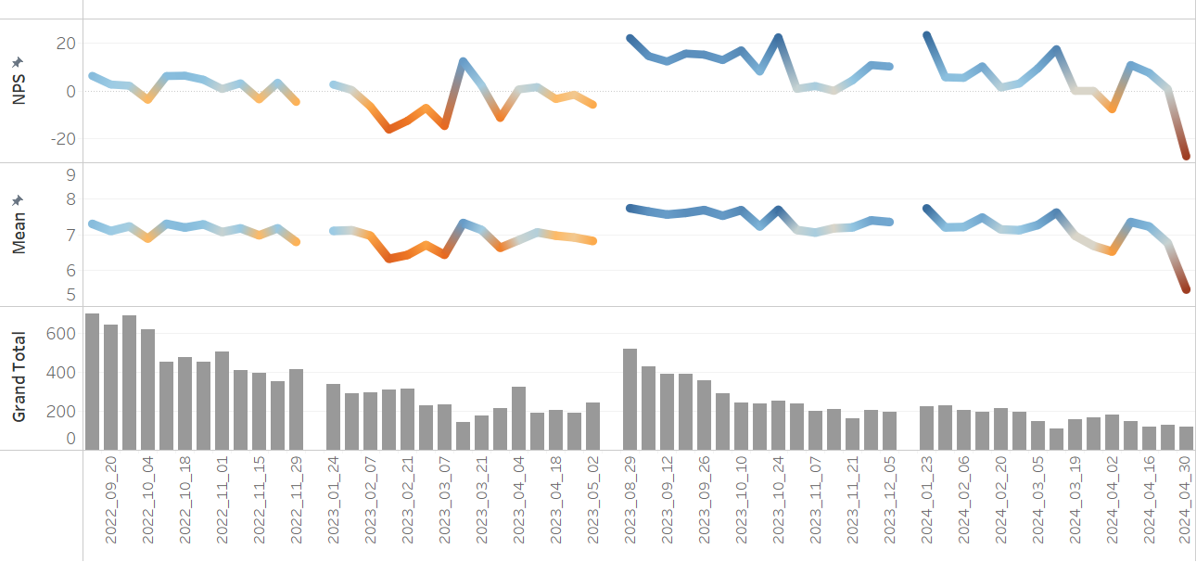
Academic Semester Results
Fall 2022
Spring 2023
Fall 2023
Spring 2024
Spring Break
Spring Break
New
Welcome
Week /
Good News
Nine
Arrests
First
Exams
Final
Exams
Parking Fees
Announced
Reaction
To Oct. 7
Twenty-Nine
Arrests

Slide 14
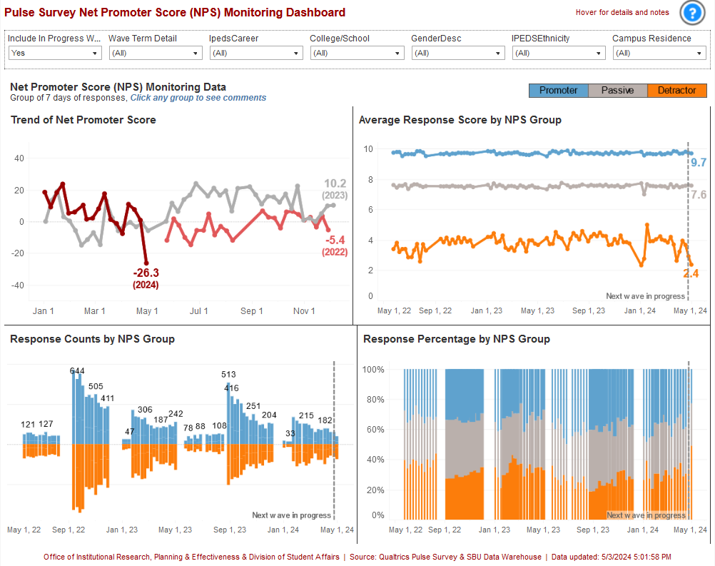
Current monitoring dashboard

Slide 15
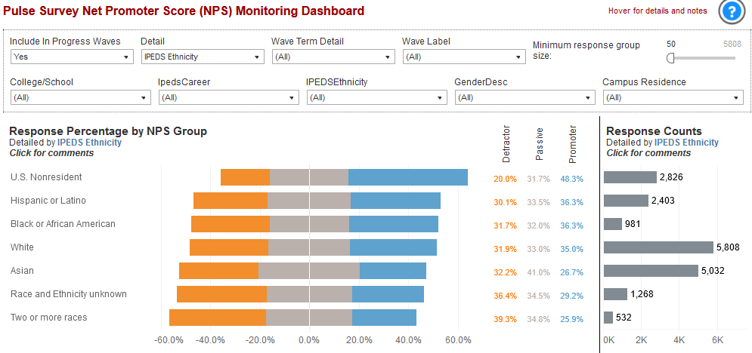
Group monitoring (Race/Ethnicity)

Slide 16
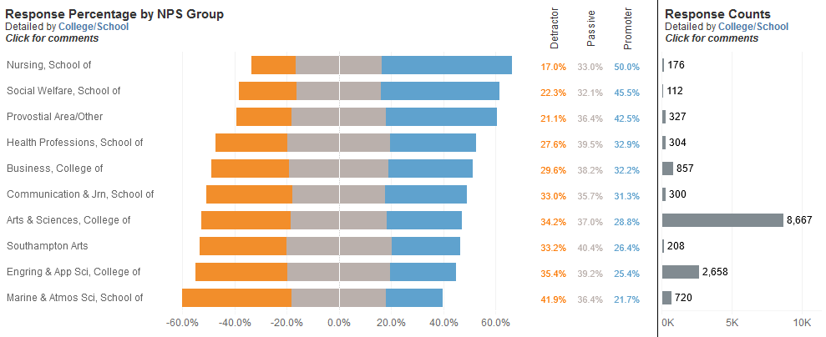
Group monitoring (UG College/School)

Slide 17
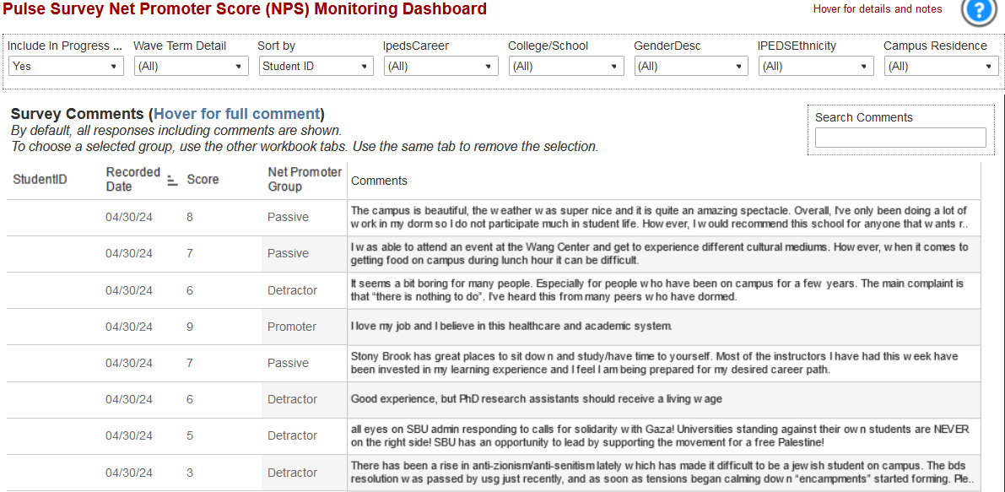
Dashboard isolates comments of a group

Slide 18
Comments are monitored
Keyword stems for self-harm, violence, mistreatment, mandatory reporting
Keywords flag a comment for analyst review and referral if appropriate within 24 hours

Slide 19
Themes from coded comments (2022-23)
 | Activities | Professors | Support | Academics | Total | Program | Dining | Cost UGRD | Cost GRAD | Parking
Promoters | 36% | 38% | 38% | 34% | 17% | 30% | 14% | 17% | 15% | 6%
Passives | 45% | 31% | 29% | 35% | 28% | 30% | 40% | 35% | 20% | 25%
Detractors | 19% | 31% | 33% | 31% | 25% | 41% | 46% | 48% | 65% | 70%
NPS | 17 | 8 | 5 | 3 | -8 | -11 | -31 | -31 | -51 | -64

Slide 20
Lessons Learned
Responses were stable by wave (a week) but not within waves (daily and moving averages shorter than a week were not stable)
Late respondents were much more negative
Sentiment tends to decline over the course of a fall or spring semester
In year 2, we found most useful distribution was comment push to senior academic and student affairs leaders.
AI might be a solution to coding responses but the jury is out

Slide 21
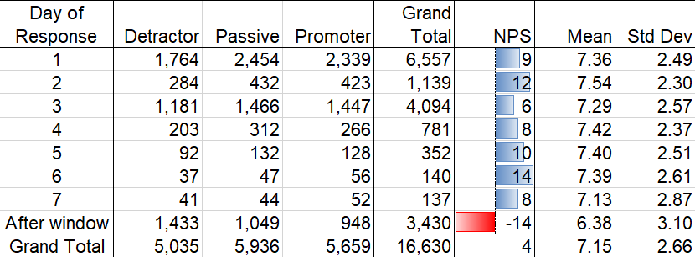
Late respondents have been much more negative
Fall and spring semester responses only

Slide 22
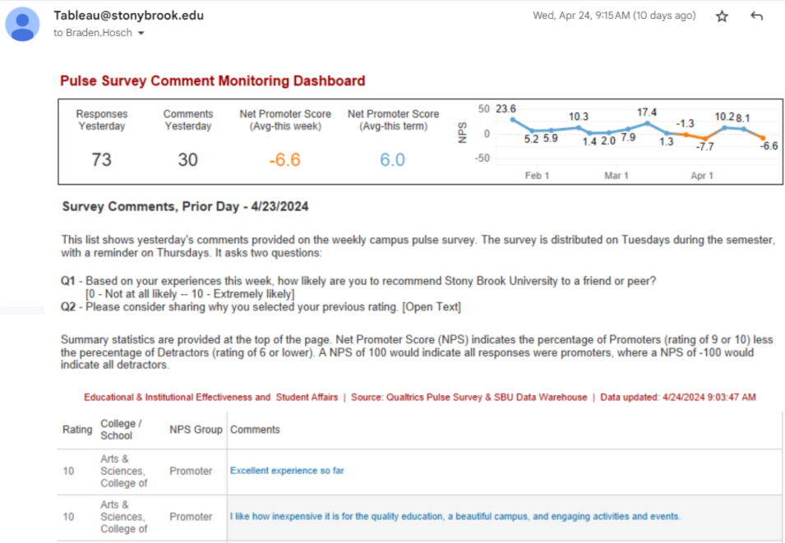
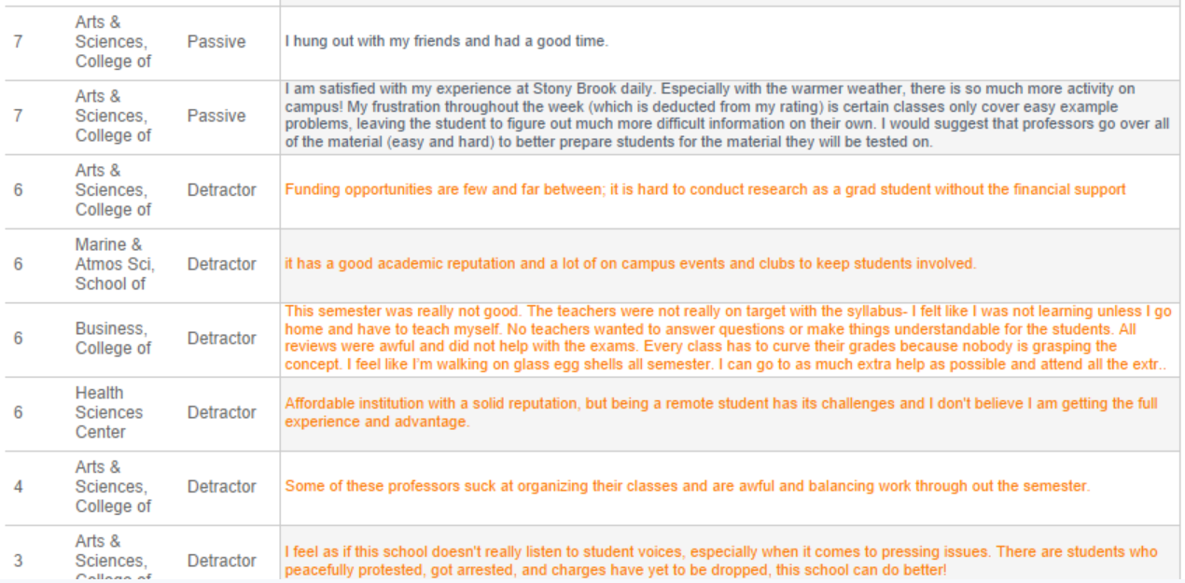
Email Push to Academic/Student Affairs

Slide 23
Artificial Intelligence Coding Results
description | Spring 2024 freq | Spring 2023 freq | Spring 2024 relative freq | Spring 2023 relative freq | relative difference | log-liklihood value
Support / Community Spirit | 162 | 295 | 1.38 | 0.91 | 1.52 | 17.56
Professor / Faculty | 119 | 242 | 1.01 | 0.75 | 1.36 | 7.33
Education | 119 | 351 | 1.01 | 1.08 | 0.94 | -0.36
Acitivties / Clubs | 95 | 189 | 0.81 | 0.58 | 1.39 | 6.65
Parking / Transportation | 50 | 253 | 0.43 | 0.78 | 0.55 | -17.25
Programs | 42 | 150 | 0.36 | 0.46 | 0.78 | -2.22
Cost / Tuition / Affordability | 39 | 215 | 0.33 | 0.66 | 0.5 | -18.22
Dining | 36 | 132 | 0.31 | 0.41 | 0.76 | -2.34
Facilities | 29 | 55 | 0.25 | 0.17 | 1.46 | 2.61
DEI | 24 | 53 | 0.21 | 0.16 | 1.25 | 0.82
Commute / Location | 19 | 37 | 0.16 | 0.11 | 1.42 | 1.5
Advising / Registration | 15 | 36 | 0.13 | 0.11 | 1.15 | 0.21
Dorm / Housing | 8 | 36 | 0.07 | 0.11 | 0.62 | -1.7
Tutoring / Extra Help / Accommodations | 5 | 20 | 0.04 | 0.06 | 0.69 | -0.58
Online / Distance Learning | 5 | 36 | 0.04 | 0.11 | 0.39 | -5.06
Admin | 4 | 27 | 0.03 | 0.08 | 0.41 | -3.42
Results from Relative Insight Text Coding

Slide 24
Final thoughts
Iteration and patience have been important
Requires bandwidth in survey analysis unit
We are not yet good enough with artificial intelligence tools to produce verifiable and replicable results
Conversations with senior leadership is important throughout about governance, privacy, communication

