Slide 1

SPEED SCIENCE 2022
Session two

Slide 2
Identifying novel NRF2 functional binding partners in NSCLC
Speed Science session 2022
Santiago Espinosa
08/31/22

Slide 3
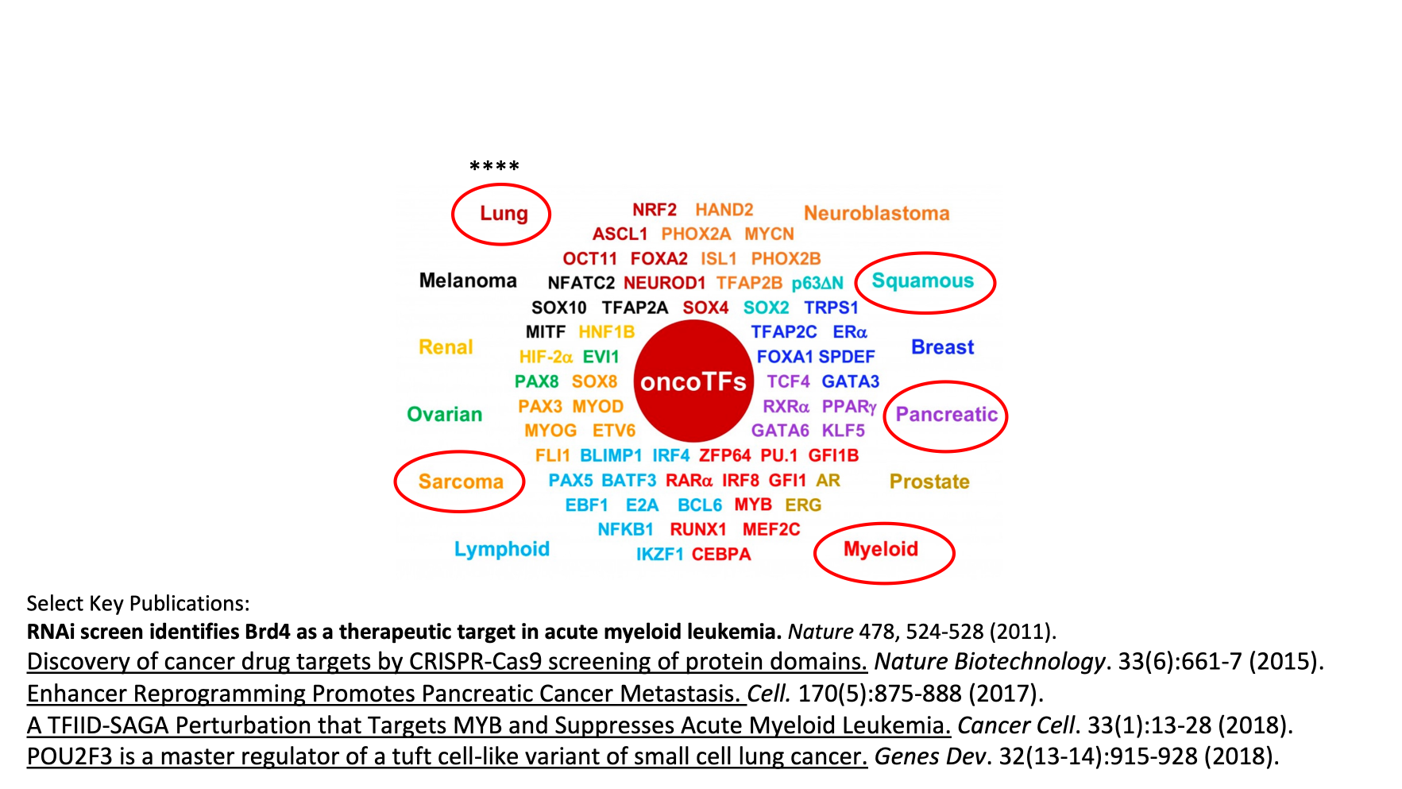
The Vakoc Laboratory
Transcriptional dependencies in cancer
Source: Connor Fitzpatrick

Slide 4
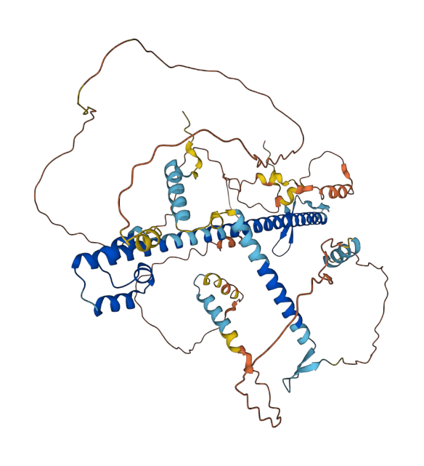
Orthogonal approach to uncovering novel binding partners of NRF2
Functional genomics:
Marker based screen
Biochemical assays:
XL-Mass Spectrometry
Unknown Binding Factors
Structural analysis:
Identify binding partners
Source: AlphaFold

Slide 5
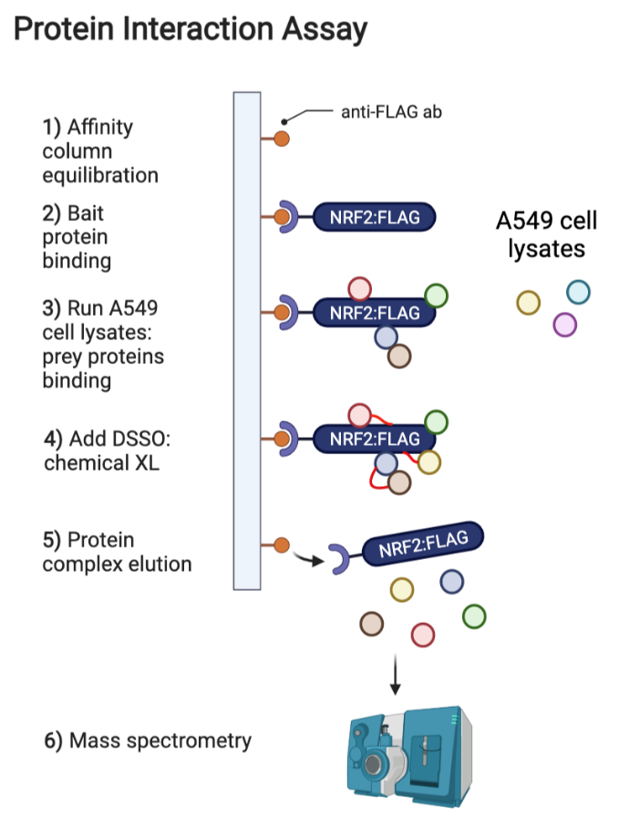
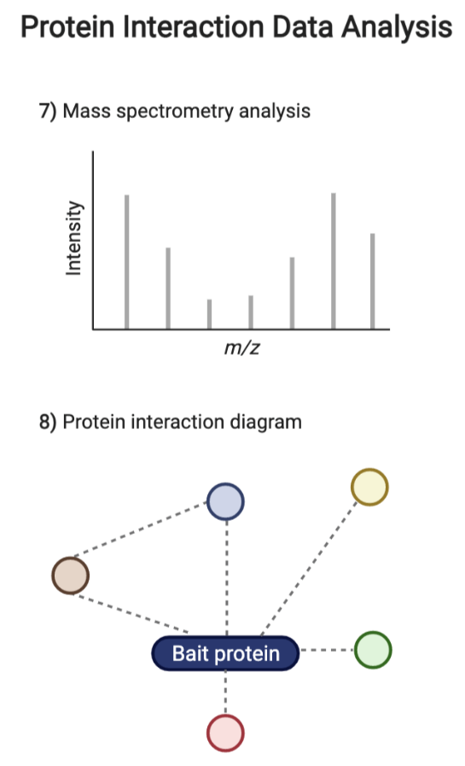
Crosslinking PD-MS
DSSO
Source: biorender.com
Notes:
This method relies on covalent labeling and cross-linking of proteins in physical proximity
Would also want to take a similar approach for the different domains of NRF2 to characterize specific binding partners for each domain

Slide 6
No Fancy Title Because I Don’t Have a Set Project but DNA Replication!
Kim Hane
August 31st, 2022
Bruce Stillman Laboratory

Slide 7
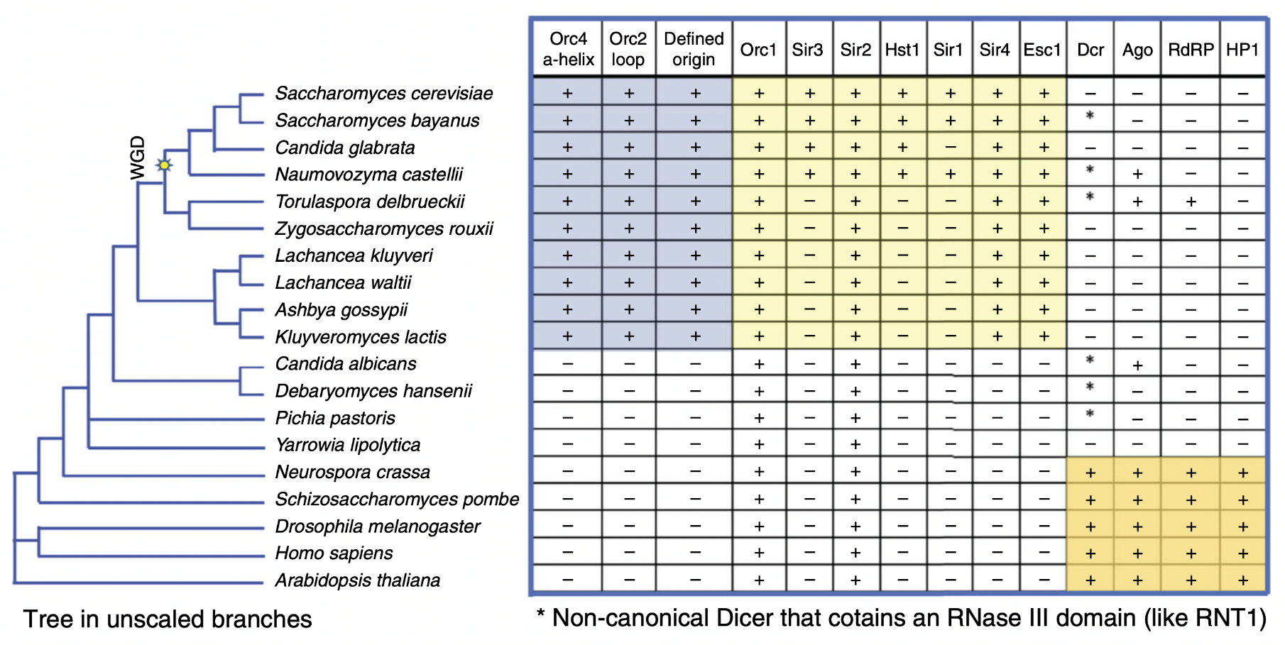
Why Study DNA Replication in Yarrowia lipolytica
Hu, Y., et al. Nat Commun 11, 5175 (2020).

Slide 8
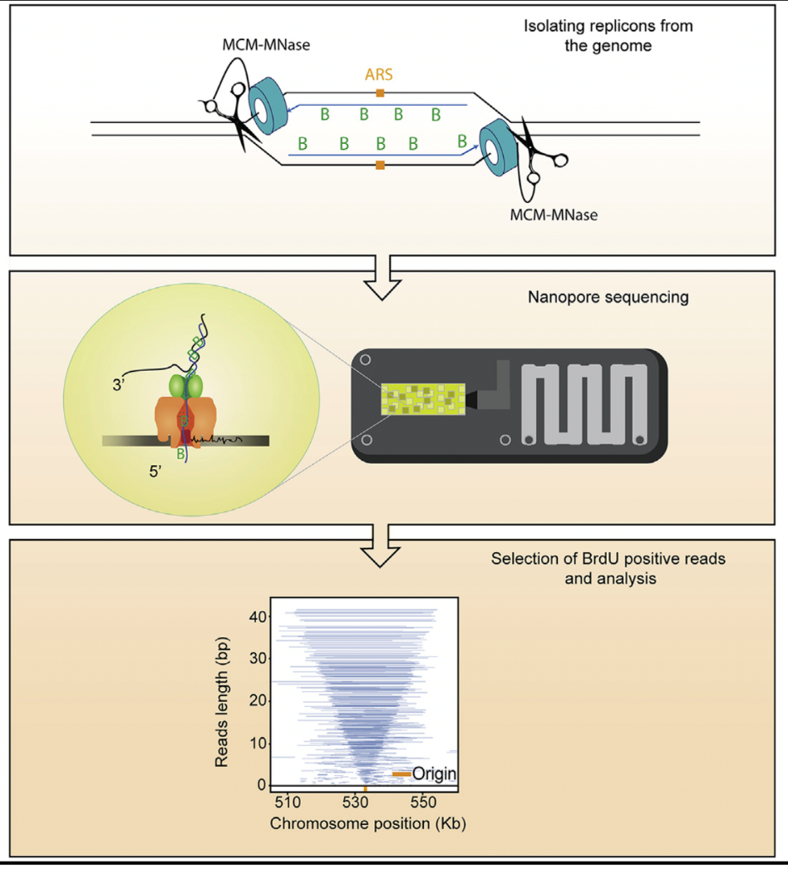

Current Work
Claussin C., et. al. Single-molecule mapping of replisome progression. Mol Cell. 2022

Slide 9

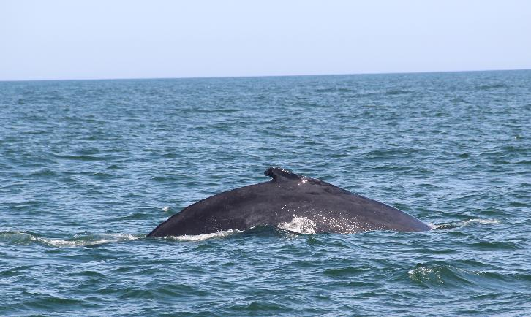

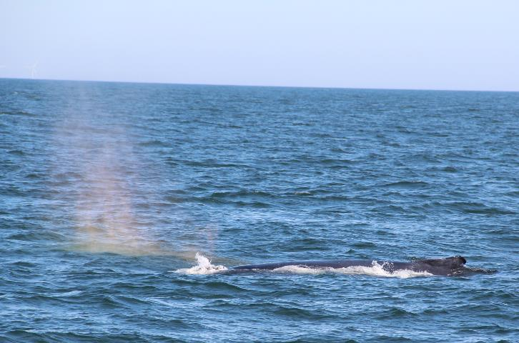
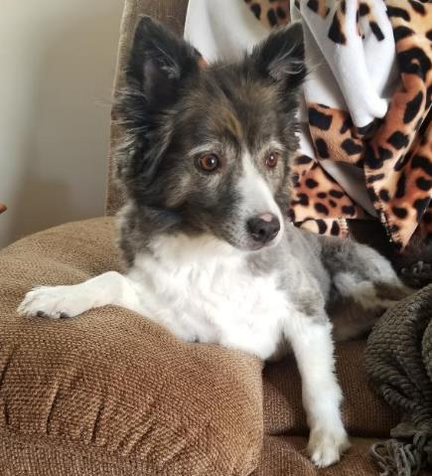
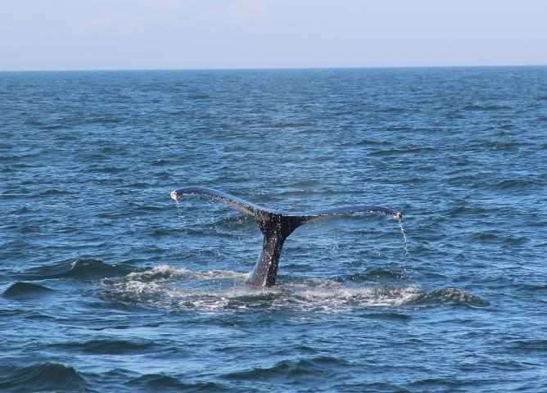
Thank You!

Slide 10
Manipulating alternative splicing in cancer as a therapeutic approach
Dillon M. Voss
Krainer Lab
Stony Brook University Graduate Program in Genetics

Slide 11
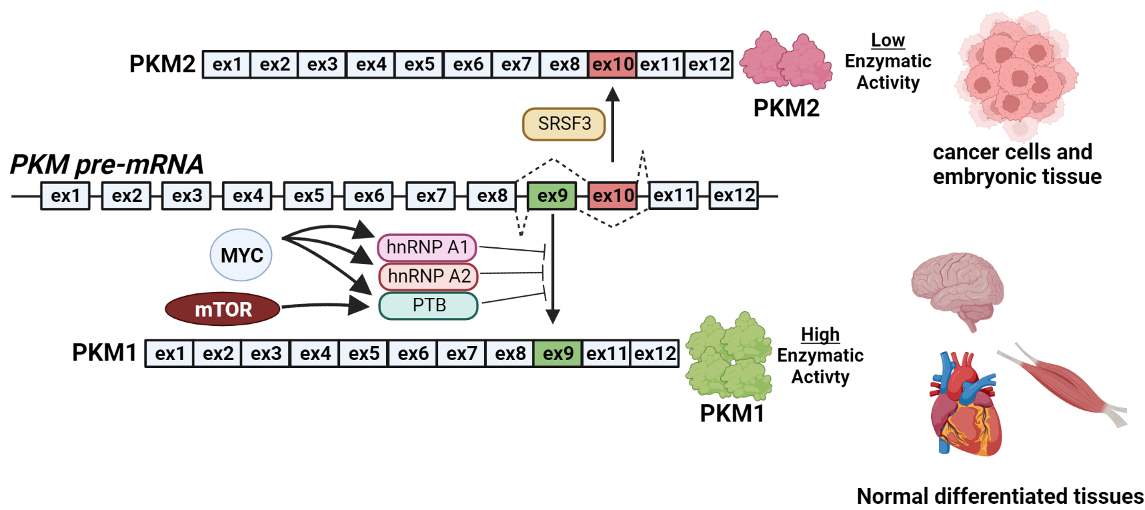
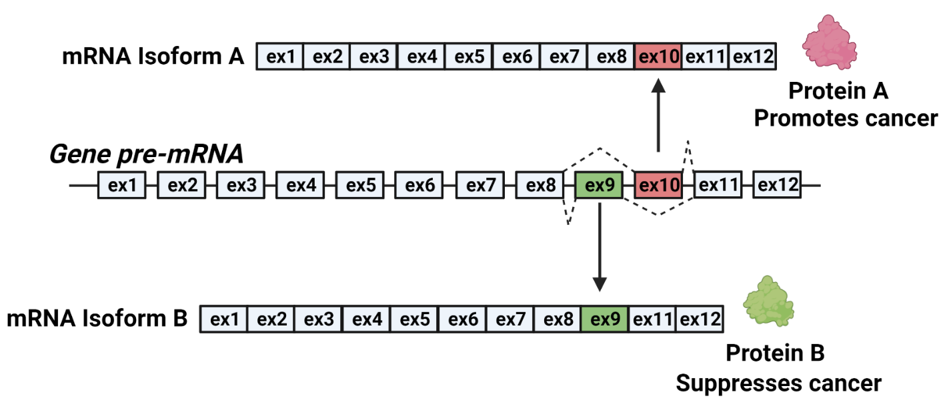
Alternative splicing increases functional diversity of the proteome and is dysregulated in cancer
PKM = Pyruvate Kinase Muscle
last enzymatic step in glycolysis
upregulated in nearly all cancers
based on: Chaneton, B., Gottlieb, E. Trends Biochem. Sci., 2012.
Notes:
Kif3A numbering is given relative to canonical 699 amino acid isoform. (2018 kinesin 2 biomechnics)

Slide 12
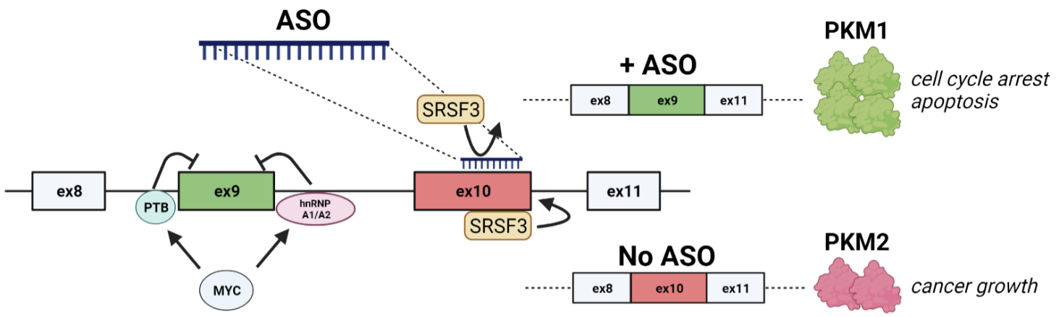
Antisense oligonucleotides (ASOs) can be used as a therapy to induce splice-switching in cancer
ASOs are typically single-stranded DNA molecules about 18 – 30 nucleotides long
Can be used to sterically block splicing enhancers (e.g., SRSF3)
Readily taken up by cells without the need of transfection reagents (e.g., lipofectamine)
Based on: Ma, W.K., Voss, D.M…Krainer A.R. Cancer. Res, 2021.
Notes:
Kif3A numbering is given relative to canonical 699 amino acid isoform. (2018 kinesin 2 biomechnics)

Slide 13
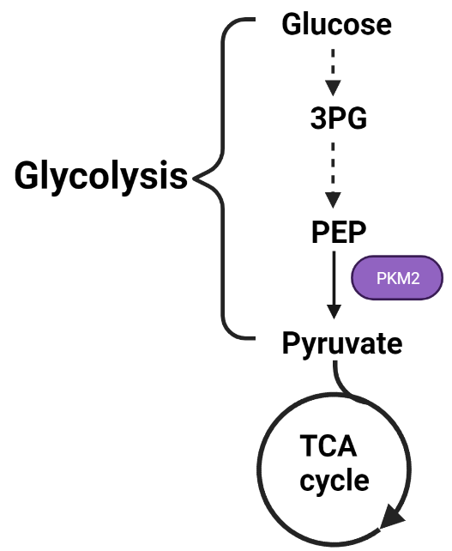
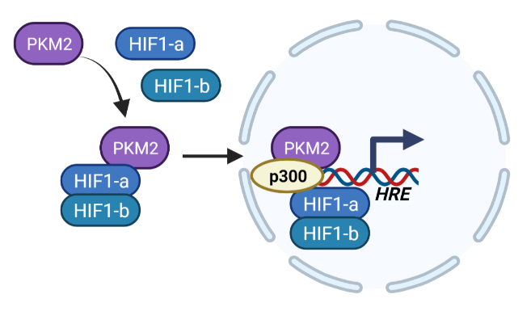
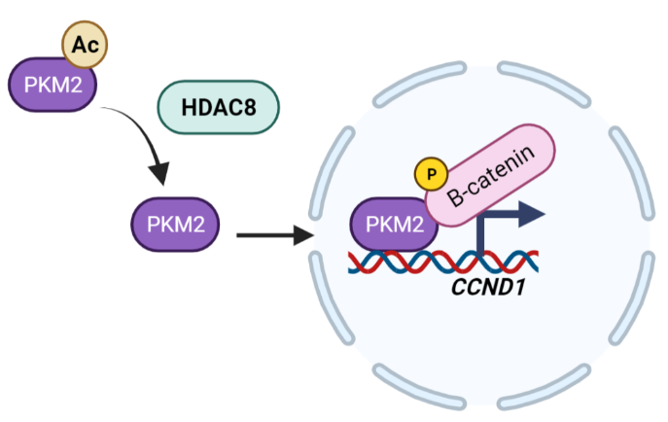
Future Plans: Functionally characterize metabolic and genetic effects of PKM splice-switching in cancer
Metabolic functions
Genetic functions
¹Zhang, R., et al. Cell Death & Dis.. 2020
²Weibo, L., et al. Cell. 2011

Slide 14
Sam Chiappone
Speed Science 2022

Slide 15
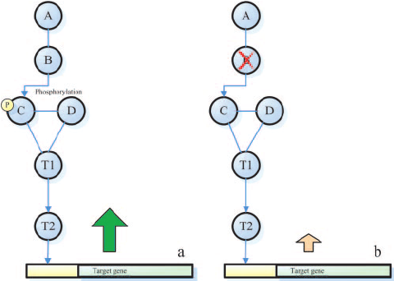
How the integration of gene-regulatory pathways produces a defined biological output is still a grand challenge in biomedical science
Tu et al. Bioinformatics 2006

Slide 16
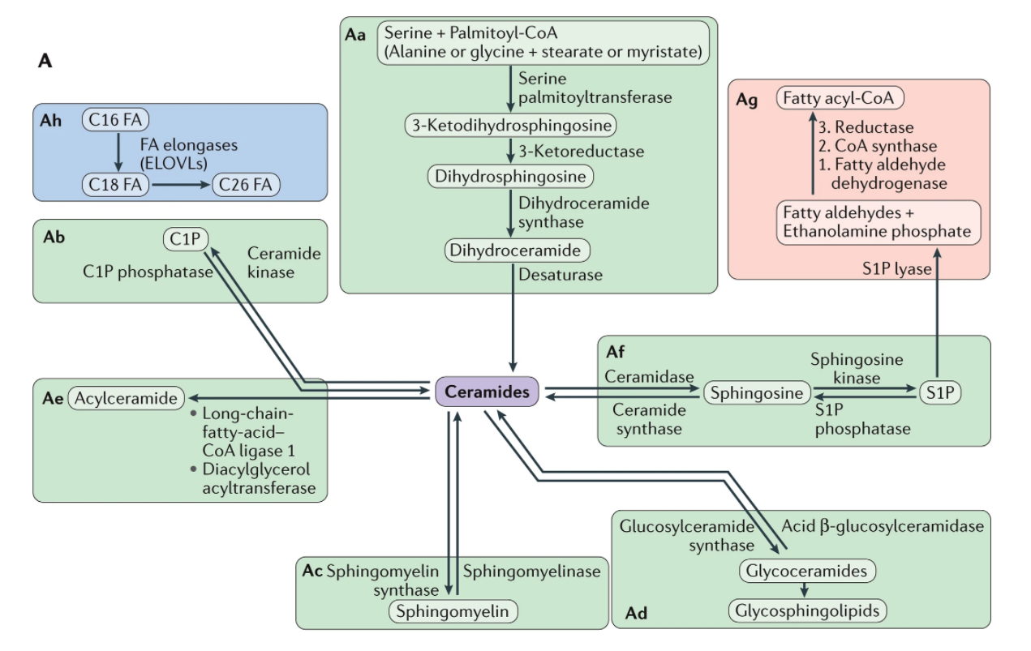
My research focuses on ceramides, the central sphingolipids
Hannun and Obeid Nature Reviews Molecular Cell Biology 2017

Slide 17
I aim to dissect the ceramide signaling network through 3 approaches:
Bioinformatic analysis to determine upstream transcription factors controlling sphingolipid enzymes
Phosphoproteomics to determine the dephosphorylation events downstream of ceramide
Transcriptomics to determine transcriptional regulation downstream of specific cellular pools of ceramide

Slide 18
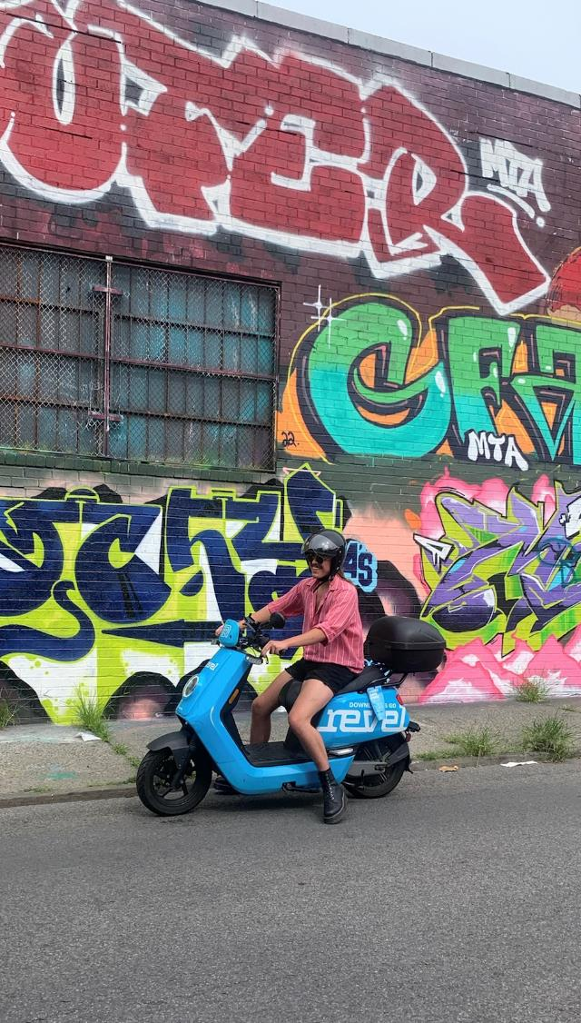


Nelson Gautier
∙Born: Lyon, France
∙Hometown: Milton, Ga
∙Undergraduate:
University of Georgia
B.S. Genetics
Athens, GA
Lab: van der Velden
Interests:
Listening to David Bowie
Board games
Cooking
Arguing

Slide 19

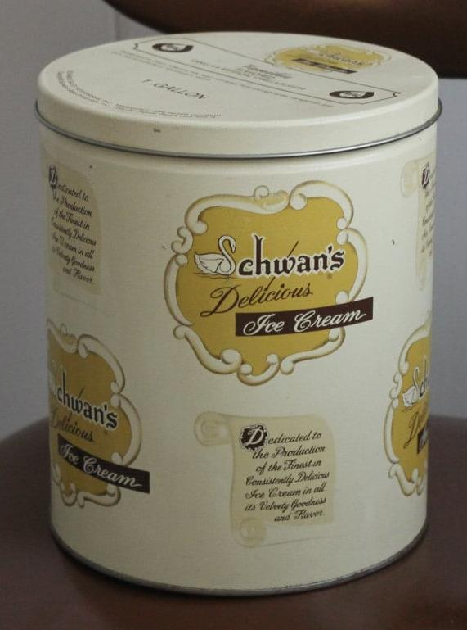

I scream… You scream… We all poop
In 1994, a Schwan’s ice cream plant was implicated in a Salmonella outbreak that made an estimated 224,000 Americans sick.
Salmonella enterica serovars are responsible for a combined global toll of approximately 1 million deaths annually.
Our lab’s research focuses on host interactions with Salmonella, with an emphasis on immunity and host defense.

Slide 20
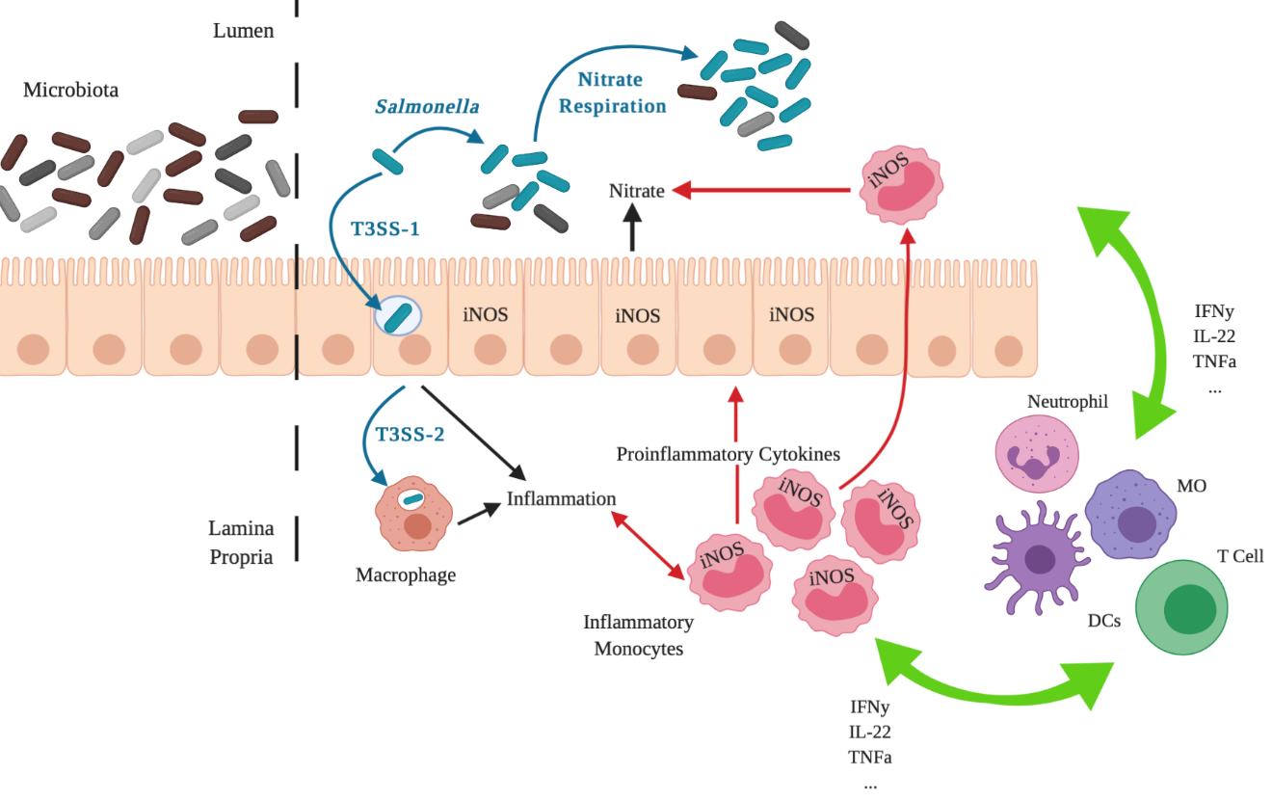
Exploring how IM promote nitrate-dependent STm expansion in the gut
Specifically, I am interested in how IMs contribute both directly and indirectly to the generation of host-derived nitrate and the subsequent expansion of salmonella in the lumen of the inflamed intestine.
Adapted from McLaughlin et al. PLoS Pathogens 2019
Notes:
Use questions efficiently to colloquially explain the knowledge gap

Slide 21

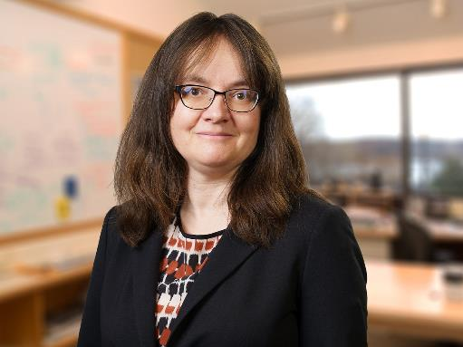


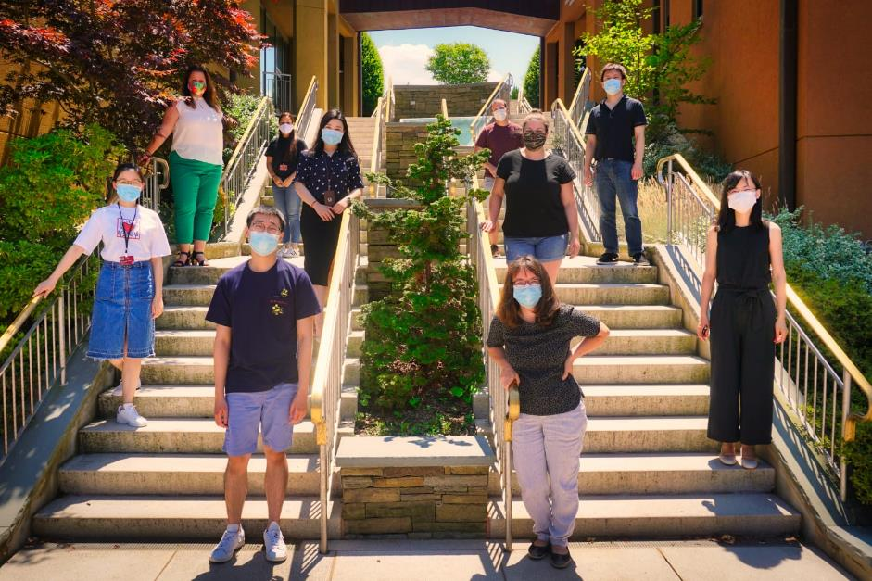


Genetics Program
Egeblad Lab
Xiao Han
4th year
@XiaoHan_CSHL
Xiao.Han.1@stonybrook.edu
xhan@cshl.edu

Slide 22
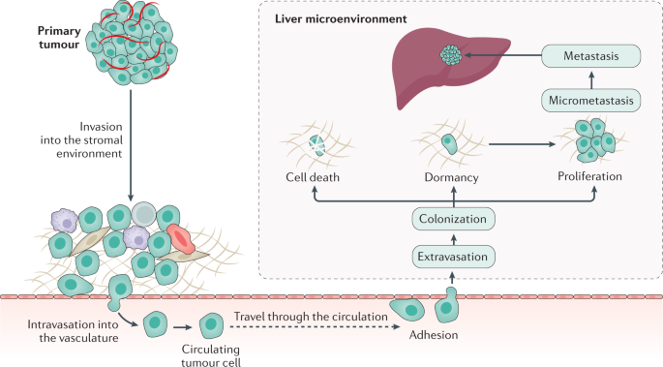
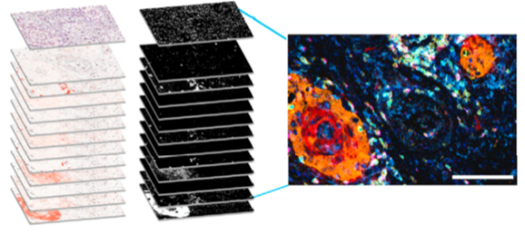
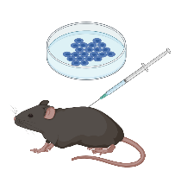
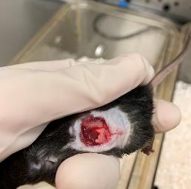
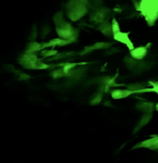
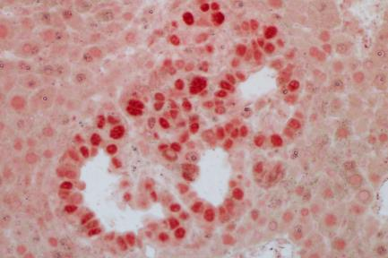
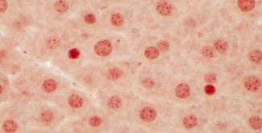
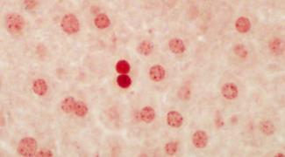
Dormant disseminated cancer cells maintain an equilibrant with host immune cells before grow out metastasis
?
Multiplex IHC
Intravital imaging

Slide 23
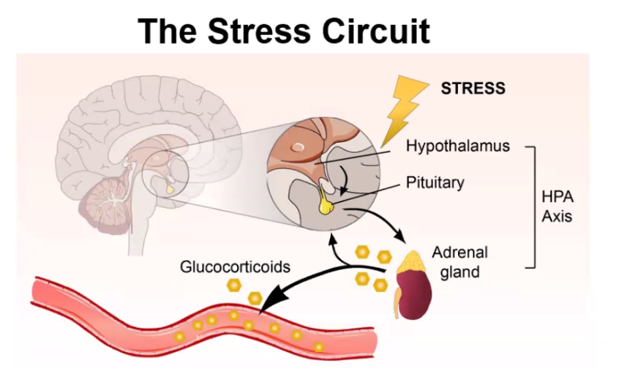


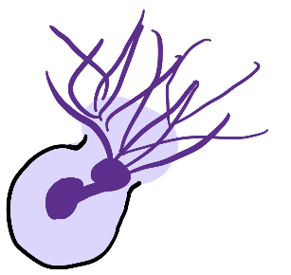
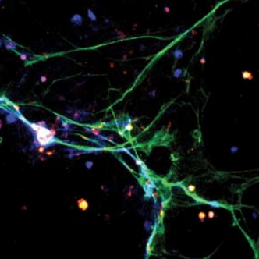
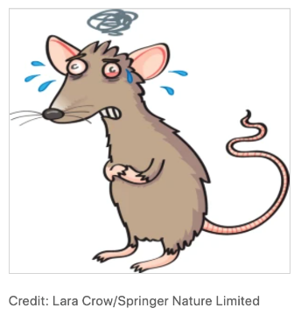
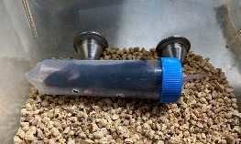
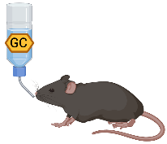
Stress induced high levels of glucocorticoid promote metastasis via NETs
PhD student
Neutrophil Extracellular Traps

Slide 24

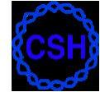
Discovering mechanisms of DNA replication initiation in budding yeast Yarrowia lipolytica
Narges Zali
PI: Dr. Bruce Stillman, CSHL
Genetics program Stonybrook University

Slide 25
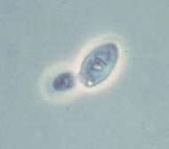
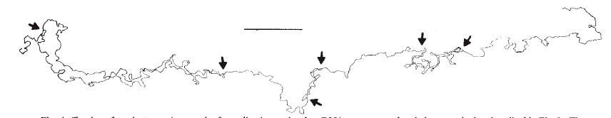


Marking of Origins of DNA Replication Across the Genome
Some origins
are not activated
except in an
Emergency
(back-up)
Origin activated
later in cell cycle
Origin activated
later in cell cycle
Budding yeast
Origin activated early
Origin activated
later in cell cycle
Origin activated early
Origin activated early
Two steps, origin licensing (G1) and origin firing (S-phase)
DNA replication fork
Pre-Replicative Complex
ORC
Potential origin
Formed on all ~400 origins of DNA replication
Across the entire genome in G1 phase
Newlon, Petes, Hereford and Fangman (1974) Nature
Notes:
The cell need to replicate its DNA the origins are spread out through out the genome, although with some organisms like cerevisiea there are seq specific origins for other higher eukaryotes its bit of mystery how these origins are spcified.
zones that range up to 500 kb in length. Replication timing is controlled by both stochastic and regulated forces and is highly plastic throughout developmental transitions
Therefore we examined ORC-origin affinity in vivo and in vitro for a large fraction of yeast origins to classify them based on which mechanism (i.e. DNA sequence vs. extrinsic, ‘chromatin’ factors) mediates their binding to ORC in vivo.
Transmission of genetic information from one cell generation to the next requires the accurate and complete duplication of each DNA strand exactly once before each cell division. Typically, this process begins with the binding of an “initiator” protein to a specific DNA sequence or “replicator.
No eukaryote other than pombe and cerevisea we don’t know how origins are specified , cerevisea and pombe are unusual seq in orc binding origins are specified

Slide 26
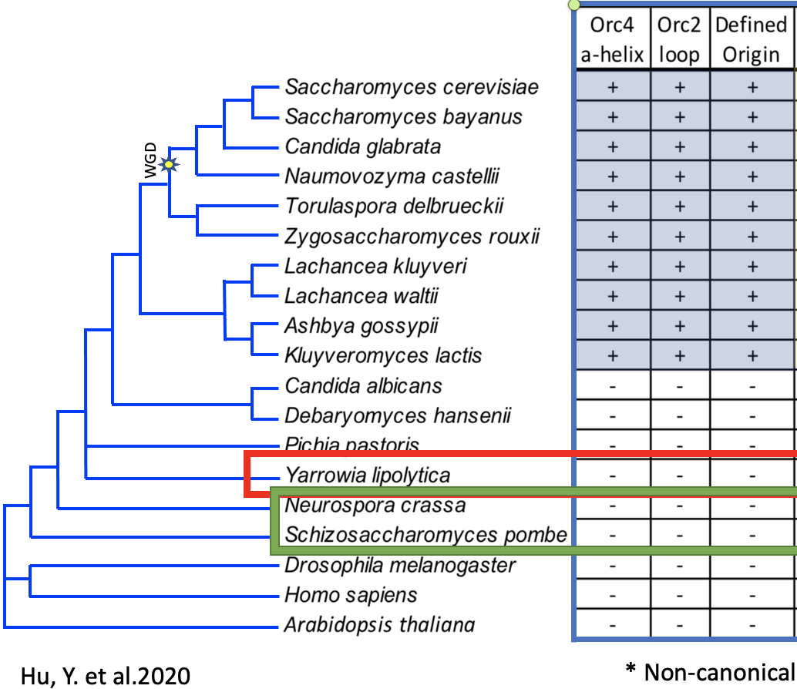
Evolution of defined origins and Orc4
Notes:
Acquisition of seq specificity orc4 alpha and orc2 loop correlates with orc-sir mediated silencing in this clade of budding yeast
Gene density and its more intergenic instead of intragenic
Remebr orc with hp1 in maamlian and swi6 in s.pombe centromere
During the S phase, DNA replication initiation sites are prone to DNA damage and transcription is robust
Therefore, suppression of DNA replication initi- ation within transcribed regions is important because it allows cells to avoid collisions between DNA and RNA polymerases, thus maintaining genome stability during early DNA replication.
rules, there are likely to be exceptions. Nevertheless, if there is a general rule that initiation occurs between genes in transcriptionally active cells, then the variation in size of the average in- tergenic region in different organisms might be respon- sible for the differences seen in sequence specificity.
Organisms like the yeasts, with a very low percentage of their genomes devoted to intergenic spacers, might, by necessity, have evolved an efficient mechanism to ensure that the replication complex can find appropri- ate sites at which to initiate. Organisms in which the majority of the genome is intergenic, have ample po- tential sites for initiation, so that sequence specificity may be more relaxed.
Localization with orc and colocalizing with sir silencing. In mating type loci orc has been shown to colocalize with sir . In rDNA sir is helping with recombination, RFB is helping with collision problem. Localizingorc with defined seq is because gene density so they have to thave defined and its more intergenic. Instead of on th emiddle ofgenes.
Acqusition of seq specificity orc4 alpha dn orc2 loop correlates with orc-sir mediated silencing
What is the significance underlying this transition?
RNA interference (RNAi) is a cellular gene silencing pathway and is lost in most if not all Saccharomycotina (budding yeast) species (I. A. Drinnenberg et al., 2009)
Dicer play roles in promoting transcription termination and resolving replication stress and DNA damage at cites where likely to be replication-transcription collisions. (S. E. Castel et al., 2014, J. Ren et al., 2015)
Possible problems in RNAi-deficient species:
Replication-transcription collisions and R-loop formation
Genome instability
Hypothesis: Under the pressure of genome instability due to transcription-replication collisions after losing RNAi, yeast came up with origin specificity and gene silencing machinery evolved in part from replication machinery.
We noticed that many fungi, including many budding yeasts, as well as all animals and plants, lack evidence for sequence specific origins of DNA replication and lack SIR-dependent gene silencing. Most have RNAi as a mechanism for transcriptional gene silencing, but one species, Yarrowia lipolytica, lacks the Orc2 loop and Orc4 α-helix, as well as SIR and RNAi gene silencing proteins. This yeast has been used by bioengineers because of its ability to produce large amounts of lipid, chemicals and enzymes for industrial applications, but the basic molecular biology of this yeast is minimal, and it is not known how the genome is copied or how origin location is specified, like the situation in most eukaryotes.
Esc1 (a Sir4 interacting protein), and components of the RNAi pathway, including Dicer (Drc) and argonaute (Ago) (orange box). The red box highlights Yarrowia lipolytica. The green highlights Orc4 with AT-hook. From ref (52). WGD is whole genome duplication.
Under the pressure of genome instability due to transcription-replication collisions after losing RNAi, yeast came up with origin specificity and gene silencing machinery evolved in part from replication machinery.
lack evidence for sequence specific origins of DNA replication and lack SIR-dependent gene silencing. Most have RNAi as a mechanism for transcriptional gene silencing, but one species, Yarrowia lipolytica, lacks the Orc2 loop and Orc4 α-helix, as well as SIR and RNAi gene silencing proteins.
onducted recently. Placing ef- ficient origins close to one another reduces the effi- ciency of firing at each individual origin [48°°,49°]. In effect, this close spacing creates a 'zone' of initiation similar to that seen, using two-dimensional gel anal- ysis, in the DHFR locus. These observations support the idea that if there is a large enough target for ini- tiation, then any one site could be used less often and the sequence requirements for these sites could be less specific. That is, if there were long enough stretches of intergenic DNA, the probability of initiation at one of many possible sites would be sufficient to ensure repli- cation of the contiguous sequences, even if these sites had low affinity for the initiation complex.
transcription regulates early DNA replication initiation by redistributing MCM complexes to non-transcribed regions to avoid replication-transcription colli- sions and thereby preserve genome stability.
At the rDNA loci, release of Pol II facilitates DNA replication and prevents homologous recombination, which would otherwise lead to loss of rDNA repeats especially during meiosis. Our results reveal a novel role for Dcr1-mediated transcription termination in genome maintenance and may account for widespread regulation of genome stability by nuclear RNAi in higher eukaryotes.
ightly compacted repetitive regions of eukaryotic chromosomes. The inheritance of heterochromatin through mitosis requires RNA interference (RNAi), which guides histone modification during the DNA replication phase of the cell cycle
es RNA polymerase II (Pol II), allowing completion of DNA replication by the leading strand DNA polymerase, and associated histone modifying enzymes that spread heterochromatin with the replication fork. In the absence of RNAi, stalled forks are repaired by homologous recombination without histone modification
Clr4 and Lid2, which methylate histone H3 lysine 9 (H3K9) and demethylate histone H3 lysine 4 (H3K4), .
we proposed a novel role for Dcr1 (Hs DICER1 homolog) in resolving transcription-replication conflicts in Schiz- osaccharomyces pombe,4 an excellent model organism to study such conflicts because its genome organization is very similar to that of higher eukaryotes.5 Dicer is an RNase III family nuclease, which cleaves double stranded RNA substrate into small RNA (sRNA) to load into the RNA inter- ference (RNAi) pathway to mediate silenc- ing at both the post-transcriptional and transcriptional levels.6 Previously we showed that S. pombe pericentromeric heterochromatin has an alternating arrangement of replication origins and
transcription units, which are transcribed at S phase when DNA is replicating. Such competition between transcription and replication requires RNAi machinery to release stalled RNA polymerase II (Pol II), allowing the completion of replication. Without RNAi, Pol II fails to release and stalled replication forks need to be repaired by HR at the expense of genome integrity and heterochromatin inheritance.
We also found that loss of Dcr1 results in the reduction of repetitive rDNA copy num- ber, likely as a result of increased recombi- nation at collision sites within the repeats.
Nevertheless, more chromosomal rearrangements in human cancers map to early- than to late-replicating genomic domains (Extended Data Fig. 9e), and early replicating fragile sites have also been identified²⁷. The collapse of forks initiating from intragenic, oncogene-induced origins could be attributed to replication–transcription conflicts, whereas forks from intergenic, constitutive origins did not collapse, even when replicating highly transcribed genes. This difference in behaviour may relate to the fact that head-on replication–transcription collisions, the most damaging type²⁸, cannot be prevented when origins fire within genes. However, for constitutive origins, which are intergenic, head-on collisions can be avoided by a genomic organization, including replication fork barriers, that favours co-directionality of replication with transcription^{29,30}. Alternatively, forks might be particularly sensitive to replication–transcription conflicts shortly after origin firing (for example, before lagging strand synthesis has converted the initial origin bubble to double-stranded DNA daughter molecules), which would explain why forks from intragenic origins are prone to collapse.

Slide 27
Why studying replication initiation in budding yeast Yarrowia lipolytica ?
How is ORC recruited to origins in Yarrowia, if Yarrowia lacks (origin specificity) ORC4 insertional alpha helix?
Are there any currently unknown origin sequences in Yarrowia that provide a basis for ORC
recognition?
The small size of the genome and evidence for lack of origin specificity, and some other similarities between
human and Yarrowia make this an excellent organism to study initiation of DNA replication and compare it to
human pre-RC assembly.
Notes:
origins cannot be genetically isolated as ARSs. The very limited (total of 8) CEN-linked genetic Ori sequences that have been examined in Y. lipolytica lack sequence similarity. Thus, how the genome replicates is completely not known. Furthermore, like most eukaryotes,, and indeed nearly all eukaryotes, Y. lipolytica lacks the protein domains in ORC that specify origin sequence specificity in S. cerevisiae and like human and Drosophila,
Sir1p is one of four SIR (silent information regulator) proteins required for silencing the cryptic mating-type locus HMRa in the budding yeast Saccharomyces cerevisiae. A Sir1p interaction with Orc1p, the largest subunit of the origin recognition complex (ORC), is critical for Sir1p’s ability to bind HMRa and function in the formation of silent chromatin. (cathrin fox)
Therefore, an ARS consensus se- quence could be part of an ORF in five of the six possible reading frames. Another constraint on ori- gin placement within genes might be that transcrip- tion through an ARS interferes with its function, and experiments have been carried out to test this possibil- ity. Insertion of the inducible GAl. promoter adjacent to ARS1 on a plasmid results in an ARS- phenotype when transformants are grown on galactose
These results suggest that the act of transcription does interfere with initiation, and the sim- plest interpretation would be that transcription occurs during S phase at the same moment that initiation at the ARS is attempted. However, the ORC is associated with ARSs throughout the cell cycle [36], raising the possi- bility that transcription may not interfere with initiation per s~, rather, disruption of the ORC at other times in the cell cycle may prevent the ORC from carrying out its initiation function during the S phase.
An alternative hypothesis is that some other feature be- sides the active process of transcription distinguishes transcription units from intergenic DNA; for example, the chromatin organization of transcription units may distinguish them from intergenic regions. The chro- matin structure of many yeast genes includes posi- tioned nucleosomes at the 5' and 3" ends, which are flanked by nuclease hypersensitive sites
surrounding chromatin and not the origin itself is the major determinant of replication timing

Slide 28
Speed Science
Craig Marshall
4th year Genetics Graduate Student
Molly Gale-Hammell Lab
6th year MSTP Student, Stony Brook University
8/30/2022

Slide 29
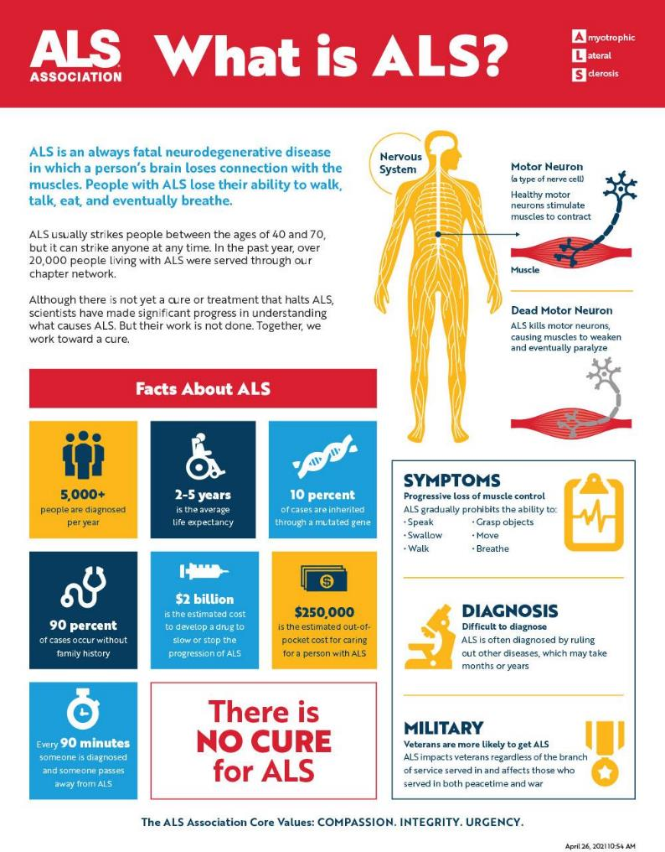
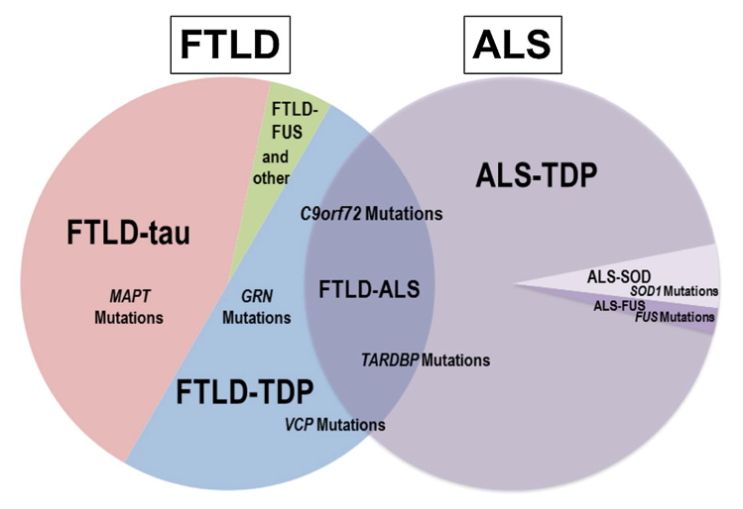
Hayashi et. al. 2016
The ALS Association
Erwin et. al. 2015

Slide 30
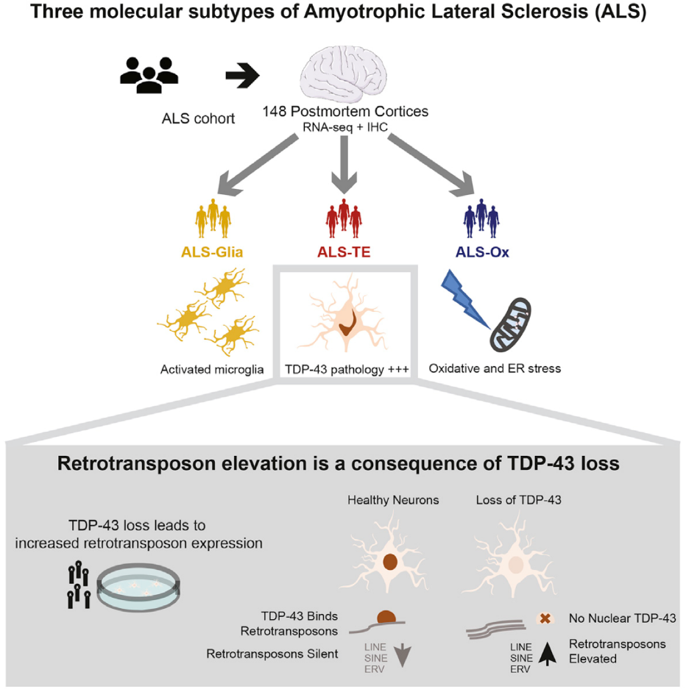
Broeck et. al. 2014
Tam et. al. 2019

Slide 31
Cells devote enormous resources to preventing TE activity
Previous lab data suggests TDP-43 regulates transposon transcripts
TDP-43
Surveillance proteins that look for TE transcripts
Surveillance proteins that look for TE proteins
Surveillance proteins that look for TE transcripts
But how specifically does TDP-43 cause TE transcripts to be degraded?
And what are the partners?
?
?
Small RNAs that digest transcripts
Protein repressors that block transcription
Small RNAs that digest transcripts
Protein repressors that block transcription
?
DNA methylation to block transcription
DNA methylation to block transcription
From Dr. Molly Hammell
Notes:
TEs silent, introduce TDP-43 early
Where a TE is regulated
And TDP-43…

Slide 32
Speed Science 2022
Phil Moresco-Fearon Lab

Slide 33
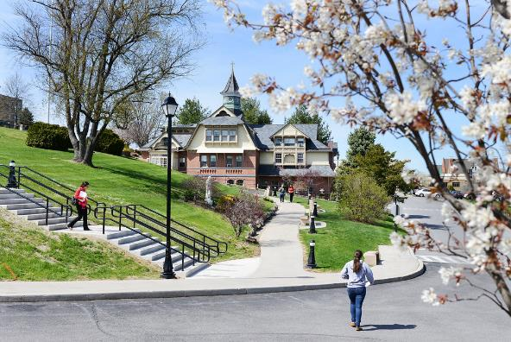
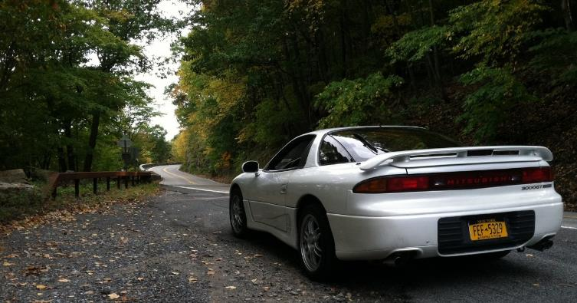



About Me

Slide 34
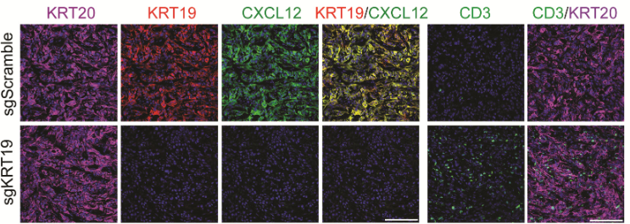
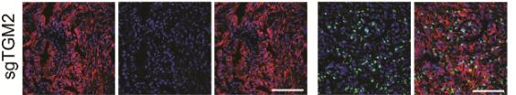
Fearon Lab
CXCL12
KRT19

Slide 35
My Project
Externalization of keratins

Slide 36
Studying life events that modify breast cancer risk
Steven Lewis
MD/PhD student
SBU Graduate Program in Genetics
Camila dos Santos lab, CSHL
8/26/22 Lab Meeting

Slide 37
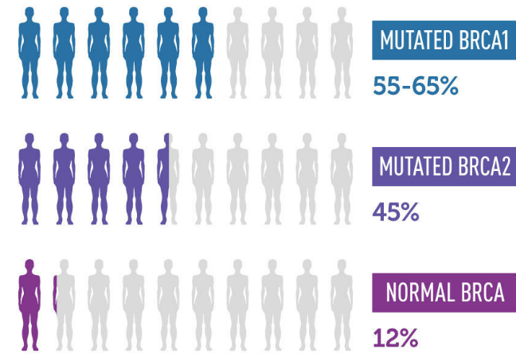
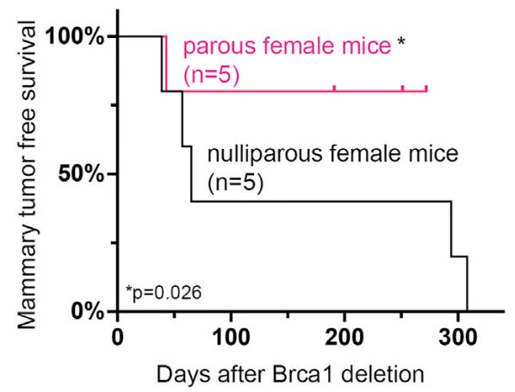


Life history events modulate mammary tumor incidence in our Brca1 KO model
NCI
Borniger et al. Cell Metabolism. 2018.
Parhi et al. Nat Comm. 2020.
Li et al. Cell Reports. 2020.
Hanasoge Somasundara et al. Cell Reports. 2021.
Notes:
Genetically predisposed host

Slide 38


UTI accelerates tumor formation in Brca1 KO mce
Brca1-MEC-Tp:
No tumors yet
Sam Cyrill, Chen Chen, City Yang, Amritha Hanasoge
Pooled Krt5^{CRE-ERT2}Brca1^{fl/fl}p53^{-/+} and Krt5^{CRE-ERT2}Brca1^{fl/fl}p53^{+/+} UTI (n = 7), PBS (n = 14). p < 0.0001 Mantel-Cox Log Rank test

Slide 39

Interpreting Bone Morphogenetic Protein Gradients in Vertebrate Development
Courtney Tello
Dr. Benjamin Martin

Slide 40



BMP morphogen gradient patterns the mesodermal germ layer

Slide 41



Are concentration dependent effects of BMP signaling accomplished through differential levels of Id proteins (direct BMP target) alone, or are they also depend on the role that BMP signaling plays in modifying cell migration?
Row, R., et al., 2016

Slide 42







A special thanks…
Benjamin Martin, Ph.D
Alex Larkin
Robert Morabito
Sam Stettnisch
Samuel Escobar
Frederick & Julia

Slide 43
Understanding the effects of modified-miR-15a mimetics in pancreatic ductal adenocarcinoma and its tumor microenvironment
John Yuen
Ju Lab
Department of Pathology

Slide 44


Slide 45












Slide 46
Aim 1: Characterize and compare the efficacy of modified-miR-15a mimetics on PDAC and its impact in chemoresistant cancer cells
Aim 2: Investigate the effects that miR-15a and modified-miR-15a mimetics have on the PDAC tumor microenvironment

Slide 47

Dexter Adams
Fifth year student, SBU Genetics
Joshua-Tor Lab, CSHL

Slide 48


The Joshua-Tor lab is interested in:
Nucleic acid regulation via RNAi pathways
DNA replication
Jaremko et al., 2020

Slide 49



Projects
Perales et al., 2014
piRNA
Determining the molecular basis of the recognition and initiation of piRNA cluster transcription
DDM1
Investigating the role of DDM1 in nucleosome remodeling, swapping of histone H3.1, and DNA methylation
lin-4
Biophysical investigation into the precise upstream transcriptional timing of miRNA lin-4

Slide 50
Deconstructing tumor – immune cell interactions in cancer
Charlie Chung
Beyaz Lab

Slide 51



Connection between immune interaction and microbiome
cytokines
CD8
TCR
CD4
MHC-I
TCR
cytokines
cytotoxic molecules
Tumor
MHC-II
cytotoxic molecules
Microbiome ?
myeloid cells
B cells
NK
Kreiter et al., Nature 2015
Hirschhorn-Cymerman et al., JEM 2012
Haabeth et al., Leukemia 2016
Tarafdar et al., Blood 2017
Tran et al., Science 2014
Spitzer et al., Cell 2017
Hung et al., JEM 1998
Janssen et al., Nature 2003

Slide 52







IFNg
PPARd agonist
TLR agonist
Bacterial culture
EZH2 inhibitor
aPD-1/ aPD-L1
Bi-specific antibody
CAR-T
Organoid-immune cell
Co-culture
Drug incubation
+/- drug
Bladder
Tumor
“In-vivo”
Co-Culture
Media/Matrigel
Tumor Organoids/Matrigel
Tumor Tissue (H)
Tumor Tissue (PDX)
Notes:
Applying to human subject

Slide 53






A role of microbiome in tumor growth
AKP
H-
H+
MC38
H-
H+
Beyaz et al (2021)

Slide 54

Rhabdomyosarcoma (RMS) Basics
Affects
children & young adults
A cancer resembling muscle tissue
Occurs globally, but local long island families have motivated this project
High risk cases have low survival rates
Current treatments are toxic and not specific
💪
👧🧒👦
☣️
📉

Slide 55

What our lab found out prior to my project
This cancer depends on a protein called MYOD to grow.
  It is a transcription factor which controls gene expression in cells.
  This is interesting because MYOD was thought to be inactive in this cancer.
  MYOD is normally only expressed in developing and healing muscle.
  This is helpful because it means less toxicities clinically if we could target its activity.
MYOD

Slide 56
My Project Goals
Use Genetics 🧬 to find proteins that control expression of MYOD in this cancer.
Investigate whether any of these MYOD regulators may hold any therapeutic value. 💉

Slide 57
Immunohistochemical and Single-Cell Transcriptomic Analysis of Distinct Ductal Lineages in Pancreatic Cancer
Abhay Kanodia
Advisor: Dr. Scott Powers

Slide 58

Acinar Ductal Metaplasia (ADM)
Peter Storz, Nat Rev Gastroenterol Hepatol. (2018)

Slide 59

Distinct Ductal Populations in PDAC

Slide 60




Ductal cells trajectory analysis in mice PDAC

Slide 61
Role of lncRNA MALAT1 in breast cancer
Disha Aggarwal
Spector Lab, CSHL
Speed Science 2022

Slide 62
Why is studying long non-coding RNAs
(lncRNAs) important?
Long non-coding RNA genes
Protein coding genes
27.5%
34%
>200bp long
No ORFs that can be translated
Based on GENCODE Data from April 2019
Notes:
Protein coding = 34%
Non – coding = 66%

Slide 63


Metastasis-Associated Lung Adenocarcinoma Transcript (MALAT1)
Overexpressed in more than 20 cancer types
Knockdown of Malat1 in PyMT mice lead to differentiation of the primary tumors and >70% reduction in metastasis to the lungs (Arun et al., 2016)
Resected primary tumor
Mechanical/enzymatic
Purification
Plating on Matrigel
Human patient-derived breast tumor organoids
Add growth factors

Slide 64





Vegetative Cells
Tetrad
Andrew Ziesel
6th Year Genetics Student
Hollingsworth Lab
*Aaron Neiman
Meiosis I
DAPI
Rec8
Meiosis II
Metaphase I
Chromosome spreads from meiotic yeast cells

Slide 65

How do chromosomes segregate during meiosis?
Crossovers are well-known for creating recombinant DNA, but this is merely a byproduct of a much more significant process
Crossovers are required for the consistent alignment and disjunction of chromosomes during meiosis
Lacking a crossover can lead to improper segregation, called nondisjunction
Nondisjunction can lead to genetic diseases and infertility in humans
Meiosis I
Meiosis II

Slide 66
Chromosome nondisjunction can be visualized in yeast tetrads
Meiosis I
Meiosis II

Slide 67
Combinatorial CRISPR Screening for Synthetic Lethal Targets in Triple Negative Breast Cancer
Shaobo Qin
Powers Lab

Slide 68


Slide 69
2022 Speed Science
Lin lab
BST 6-180
Chuankai Chen

Slide 70

PI3K/AKT signaling
*
Janku, et al. Nat Rev Clin Oncol 15, 273–291 (2018)

Slide 71



Slide 72






Samantha Henry : Dos Santos Lab
UTI Infection
Age
Menopause
Genetic Factors
Pregnancy
Gender
Notes:
Before 25 30% decrease in breast cancer risk

Slide 73








Aged Mammary gland organoids Have inefficient response to pregnancy hormones (More to Come Nov. 9th)
Young Essential (YE)
Young Complete (YC)
Aged Essential (YE)
Aged Complete (AC)
Myoepithelial (Myo)
Bipotential (Bi)
Proliferating Bipotential (PBi)
Common Luminal Progenitor (CLP)
Luminal Ductal 1 (LD1)
Luminal Ductal 2 (LD2)
Proliferating Luminal Ductal (PLD)
Luminal Alveolar 1 (LA1)
Luminal Alveolar 2 (LA1)
Luminal Alveolar 3 (LA3)
Proliferating Luminal Alveolar (PLA)
CLP
LD1
LD2
PLD
LA1
LA2
LA3
Myo
PBi
PLA
Bi
Young Complete
Aged Complete
Pathways Associated with Estrogen, Progesterone and Prolactin
Pathways Associated with Estrogen, Progesterone and Prolactin
Notes:
Cagmyc mouse model in which cMyc overexpression in mammary epithelial cells is driven by dox treatment
Pregnancy over 38 years increase risk by 30-50% of more aggressive subtypes

Slide 74





Acknowledgements
Dos Sanotos Lab Members
Camila dos Santos
Sabrina Boettcher
Chen Chen, Samantha Cyrill,
Mackenzie Callaway, Deeptiman Chatterjee
Michael Ciccone, Marygrace Trousdell
Amritha Varshini Hanasoge Somasundara
Jenelys Ruiz, Steven Lewis
Dhivyaa Anadan, Lucia Tellez Perez
James Rail, Michelle Ciccone
Genetics Program
Martha Furie
Jennifer Jokinen
Committee
Christopher Brownlee
Molly Hammel
Rumela Chakrabarti
Esperanza Arias-Perez
About me:
Love to Play Volleyball
Enjoy Cooking
Watching Sports

