Slide 1
WolfieONE
Change Leader Network Recap
January 10, 2025

Slide 2
Agenda
Change Leader Network | 3-8
WolfieONE Foundations | 9-13
WolfieONE Changes | 14-16
COA | 17-18
Oracle Cloud Overview | 19-24
HCM Change Impacts | 25-32
ERP Change Impacts | 33-35
Personas | 36-38
Next Steps | 39-42
Appendix | 43-49

Slide 3
Change Leader Network (CLN)

Slide 4
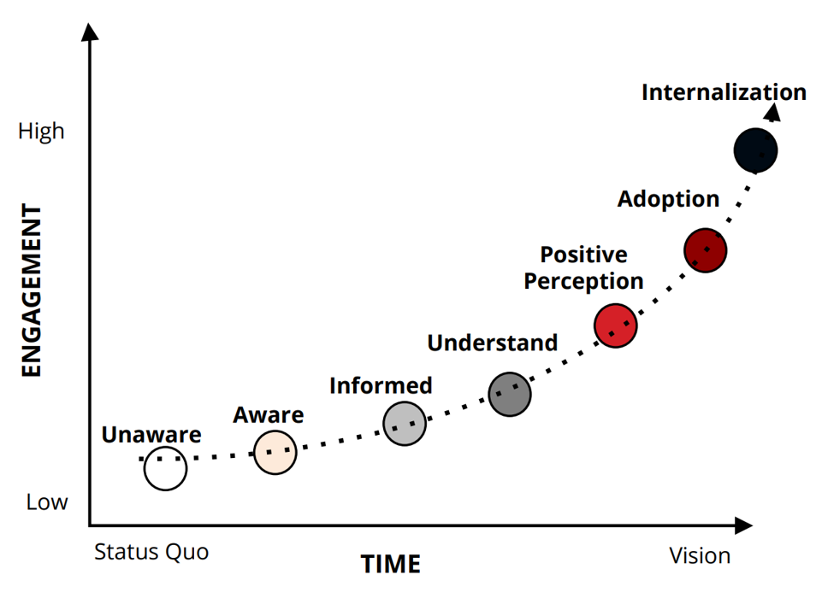
Change Management Foundations
The Engagement Curve

Slide 5
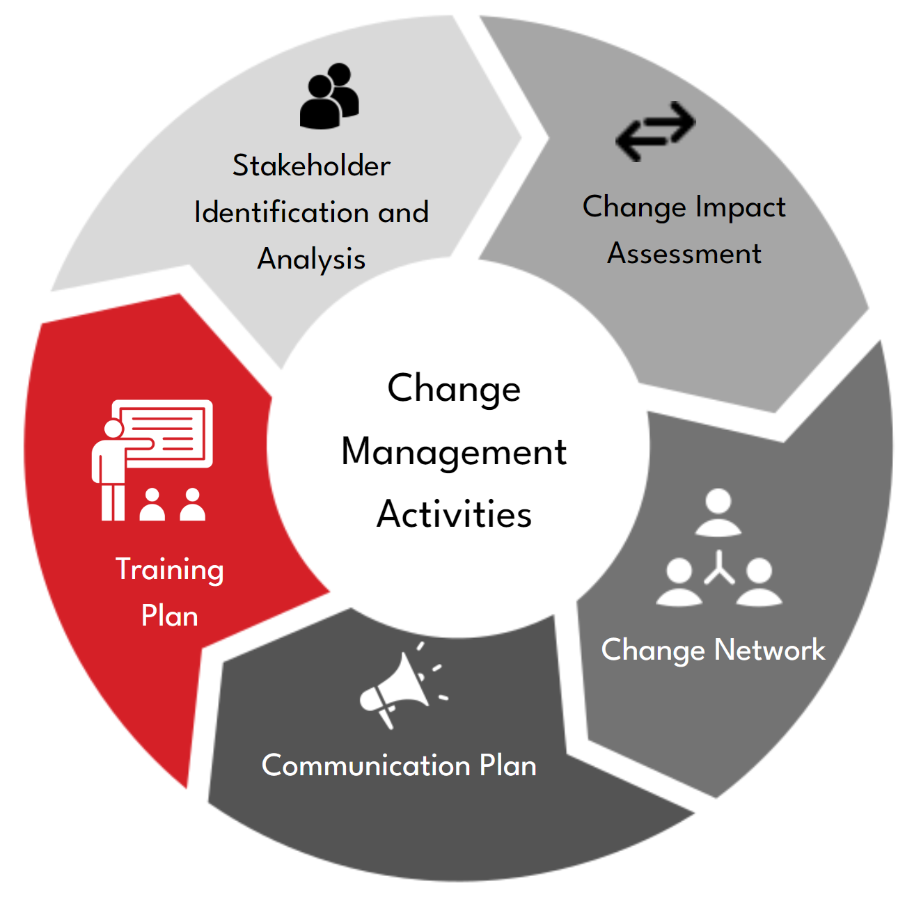
What is a Change Leader Network?
An integral part of the Change Management Methodology at Stony Brook
A peer-led group of influencers and impacted users across Stony Brook who will assist in building awareness, active listening and gathering concerns, promoting buy-in, and providing support to stakeholders impacted by the project
An indispensable asset to drive and support change adoption
Reward & Recognize Change Champions
Define the roles and duties of a Change Leader
Follow Up with Nominated and Volunteered Candidates
Ask the Managers to Nominate Candidates
Manage the Change Leader Network
Kick-off the Change Leader Network
Define the Criteria for Selection of Change Leaders
Provide an Overview to Managers
Design Change Network Strategy
Develop Change Network Plan
We are here
Conduct training(s)
Socialize Network​
Leverage for driving change
Provide Support, as needed​
Gather feedback

Slide 6
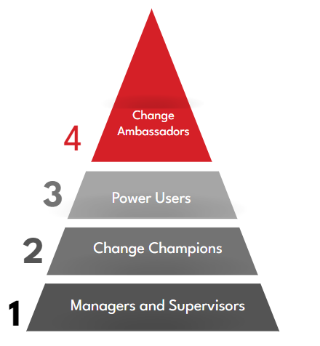
Change Leader Network Structure & Benefits
Promote understanding to assist employees in understanding changes and dealing with uncertainty
University Leadership
Advocate positive change through face-to-face and informal communications to change behaviors
Expected to understand business context, transactions, procedures, systems, and end-to-end processes
Build accountability and ownership
Build a community of early adopters who value the opportunity to try out new technology first and get a chance to demonstrate their leadership skills
Active change agents for peer network
Day-to-day support for direct reports
Accelerate the adoption of the change by quickly disseminating timely and accurate information and building trust

Slide 7
Champion Role
Champion the Program
Promote our Guiding Principles
Participate
Promote yourself as a Champion
Spread awareness & key information from program to peers & community
Share the expected benefits
Stony Brook First
Transparency and Inclusion
Governance
Single Source of Truth
Optimized Operations and Processes
Transformation
Attend monthly one-hour Change Leader Network meetings
Accept invites, show up, be engaged
Attend program and/or workstream-related events and activities (webinars, roadshows, townhalls, etc.)

Slide 8
Change Champion Journey
Change Champions will be asked to act as representatives from their departments or units and as partners of the WolfieONE program, and align their WolfieONE expertise with modules/processes, rather than departments.
1. Tell the Change Story (Spring 2025)- not the data
Help peers understand what’s “in it for them”. Work with OCM to construct a shared “Change Story” at your next leadership meeting, in your upcoming departmental newsletter, or via existing communication channels
Be realistic and recognize that change is challenging, “status quo bias” is expected
2. Provide Honest Feedback (April 2025)
Leverage your subject matter expertise and familiarity with your peers and counterparts to help us shape communications, engagement, and training
Provide input and feedback on program communications
3. Build Trust (ongoing)
Engage others with whom you have influence, build support (informal networks matter!)
Become a trusted communicator by taking on the responsibility of keeping your department or group “in the know”
5. Monitor Resistance & Empower End Users
Serve as an informal “go-to” point of contact for two-way communications
Escalate obstacles that are preventing your group or department from being ready for change as you empower them to be confident that they are prepared for go-live
4. Champion Change (ongoing)
Continue vocal support as go-live approaches
Use existing forums and channels to build awareness
Reinforce the focus on the overall vision (the bigger picture)
Put up go-live posters in your office / workspace with the QR code that will link to formal training (closer to go-live)
Use WolfieONE Zoom backgrounds
Go Live
6. Support Adoption
Partner with project leaders to drive adoption and connect end users to support channels
Set an automatic email reply to reinforce key messages (e.g., “Need help registering for courses this month? Reach out to ocm@stonybrook.edu”)

Slide 9
About WolfieONE

Slide 10
WolfieONE – “How to explain it”
Business Transformation Initiative:
WolfieONE is more than just a software update. It is a strategic transformation initiative that will design and implement an Enterprise Resource Planning (ERP) ecosystem at SBU, supported by Oracle, to better support our financial, budget, HR and business operations.
The new, cloud-based software will replace some of our systems but will also seamlessly integrate with many existing systems.
Our WHY: Beyond the business reasons that became apparent during and post-pandemic, there are human capital drivers for this initiative, such as employee morale and institutional reputation.
The industry is moving from on-premise to the cloud in a number of ways. To remain competitive, modernizing archaic systems and processes is essential.
The employee experience and how you spend your time interacting with data is one of our top reasons for this transformation.

Slide 11
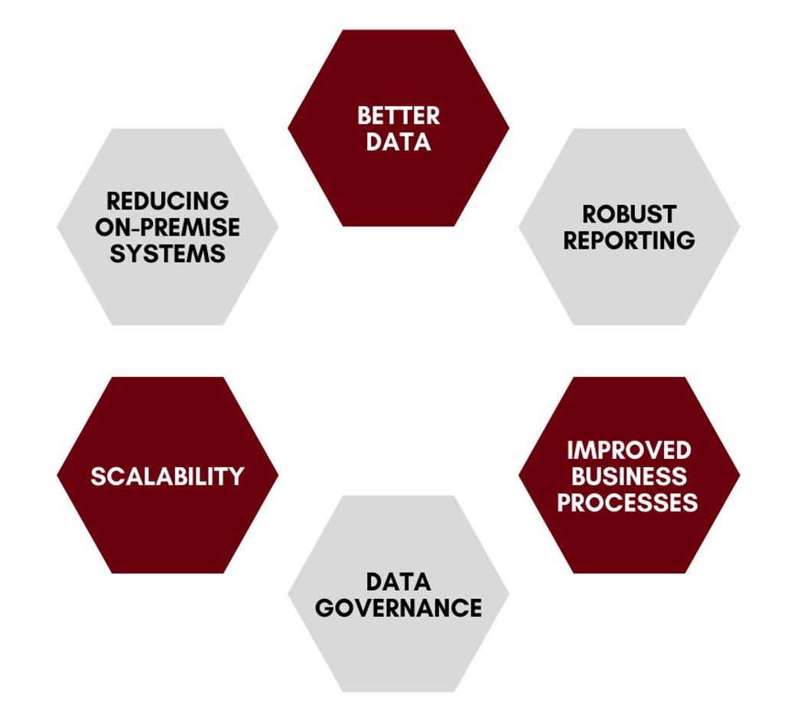
Expected Benefits
Gradual reduction of on-premise (i.e., campus-based) systems, paper-based processes and labor-intensive manual processes​
Better integration across various ERP modules which supports smoother transaction processes and more powerful blended analytics/reports​
Integrated information systems that provide more up-to-date and accurate financial and operational data that increases transparency, and enhances planning and forecasting efforts​
Robust reporting capabilities​ enabling better decision-making as well as managing from a holistic vantage point rather than a siloed view​
​ Increased automation and self-service processes (and fewer human errors as a result)​
Simpler, more intuitive, modern user experiences and enhanced cloud-based ​data security

Slide 12
Entity Scope ERP & HCM
The purpose of this Entity Scope view is to articulate how user populations within the below entities will align with respect to Day 1 Future-state WolfieONE application use and/or data integration. The Legal Entities that will be configured in Oracle is separate from this scope view.
Functional Area | Entity
Functional Area | SBU | SBF | FSA | RF ³ | SBM
 |  |  |  |  | SBUH ¹ | LISVH ¹ | CPMP | ELI ² | SBSH ² | Other Affiliates ²
ERP | Yes | Yes | No | Integrate | Integrate | Integrate | No | No | No | No
HCM | Yes | No | No | Yes | Yes | Yes | No | No | No | No
Definition
Yes | Populations within this entity will log on to WolfieONE Oracle Cloud to transact and/or perform reporting activities.
No | Populations within this entity will not log on to WolfieONE Oracle Cloud to transact and/or perform reporting activities.
Integrate | Data from this entity will integrate with WolfieONE Oracle Cloud.
Notes
SBUH / LISVH: EPM at summary level - they have their own budget system for daily operations. ERP – integrate for URAS reporting purposes – they have their own GL. Will load audited financial statement data to FCCS for consolidated financial reporting. ELI/SBSH/Other SBM Affiliates: These entities will load audited financial statement data to FCCS for consolidated financial reporting. RF: HCM consideration – RF employees include select CPMP and SBF staff.

Slide 13
Workstreams relevant to Champions for now:
Enterprise Resource Planning (ERP): all things Accounting & Reconciliation!
Note: Student receivables and SIS are not changing (Campus Solutions).
Human Capital Management: HR processes
What’s not changing: Interfolio, Handshake, Kronos, and HealthStream
Enterprise Performance Management: Budgeting, planning and forecasting.
Technology: particularly Reporting (queries, out of the box, custom)
Change Management

Slide 14
WolfieONE - Changes

Slide 15
What’s Changing?
CURRENT STATE SYSTEMS/PROCESS​ | FUTURE STATE SYSTEMS/PROCESS​
Inconsistency across processes and practices​ | Standardize processes and practices (80/20)​
Oracle/PeopleSoft software for Finance | Enterprise Resource Planning (ERP) Cloud
Oracle/PeopleSoft software for Human Resources​ | Human Capital Management (HCM) Cloud​
Campus Budget Module (CBM) for Budget and Planning ​ | Enterprise Performance Management (EPM)​
SOLAR (time and attendance; employee information, NOT the student side)​ | Human Capital Management (HCM) for reporting time and attendance
Recruiting and onboarding in Taleo​ | Oracle Recruiting Cloud (HCM)​
CPR (Capital Planning, construction) | E-builder, which will integrate with EPM

Slide 16
What’s not Changing?
CURRENT STATE ​ | FUTURE STATE INTEGRATIONS​
Jaggaer (WolfMART) SUNY system-wide SaaS solution for Procurement​ | Some fields will require the new COA, integration with Oracle, end-user will continue to use Jaggaer
Concur for travel & expense reimbursement ​ | End-user will continue to use Concur but will have to know their COA Org and Fund Source. ​
Hospital - Finance (Lawson)​ | Hospital finance professionals will continue to use their current COA in Lawson​. Exception: patient refunds team in accounting, and budget officers.
Student Information Systems​ | The student records (both academic and tuition/fin aid) side of SOLAR will remain the same. Students’ employee records will exist separately from their Academic record in WolfieONE.​
Hospital usage of Kronos | Will integrate with SUNY system for payroll purposes.
Interfolio | Faculty will be hired in Interfolio and then their data will flow to WolfieONE (Core HR) for onboarding.
HealthStream | The hospital will continue to use HealthStream, and it will integrate with the Learn module of HCM.

Slide 17
Chart of Accounts (COA)

Slide 18
Terminology
Hierarchy: a structure that provides summarized nodes used to report on all the "children" that fall below it. Oracle gives the ability to rearrange the children values into alternative hierarchies that also summarize the reporting view.
The parent and child levels are part of the hierarchy for each segment in the chart of accounts.
The child represents the lowest level in the hierarchy. The child values are the values used when entering transactions.
The parent(s) represent reporting nodes that group the child values that are found below the parent in the hierarchy. Parent(s) are used for efficient reporting and queries.
Chart Segment: Every segment is a critical dimension in representing some aspect of the business – legal, financial, operational, management – “tagging” every transaction, like a hashtag or a label. The future state “golden rule” is for each segment to have a single and standard use for every segment across departments. No “co-mingling” of purposes.
Attribute: acts like a static tag of the chart segments to provide an alternative way to write reports. Example: Academic vs. Non-academic Orgs.
Chartstring: The combined segment values, in a fixed order, is called a chartstring. Every event on a transaction that has a financial impact generates accounting entries, posting it to a combination of segment values in the General Ledger. This illustrates what a chartstring looks like:

Slide 19
Oracle Cloud Overview

Slide 20
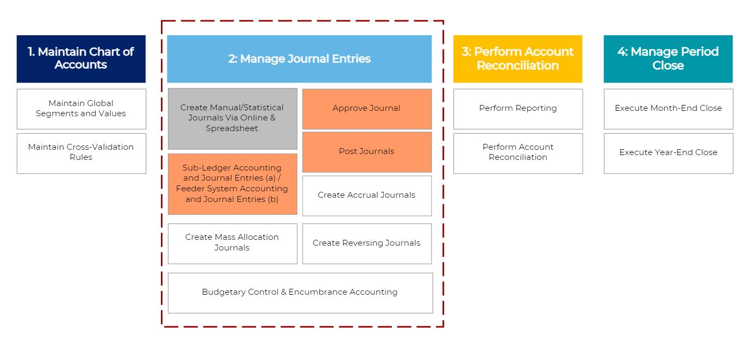
ERP General Ledger breakdown

Slide 21
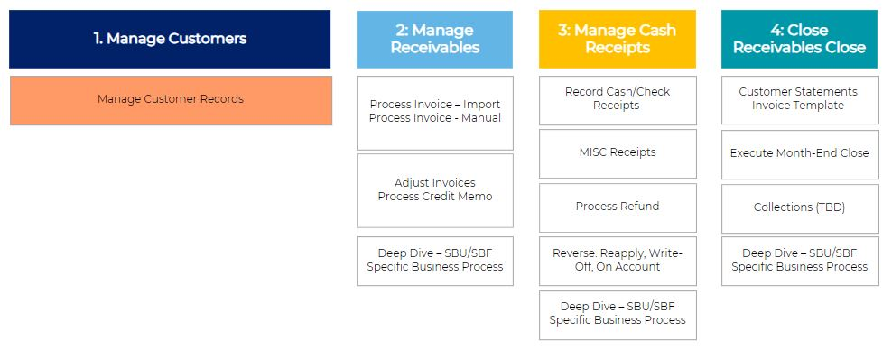
ERP Receivables (AR)
ERP Fixed Assets

Slide 22
ERP Cash Management breakdown
ERP Payables (AP) Refunds only
Types of refunds:
- Student
- Patient
- Department
- AR credit to an external party
Manage Cash Management
1. Manage Bank Master Data
Manage Payments
2: Manage Bank Account Transfer
1. Manage Suppliers
3: Receive Bank Statements
2: Manage Period Close
4: Reconcile Bank Statement
3: Manage Payables Invoices

Slide 23
EPM
Budget Formulation
Non-Personnel Expenses Entry at COA level; Revenue Entry at COA level; Strategic Planning
Driver-based Revenue Modeling; Target Setting
Systematized central planning and forecasting
Scholarship Discount Model
Base / Fiscal Planning
Overhead and Fringe Cost Planning
Budget Management
Multi-year Forecasting/ Projections
Budget Adjustments (COA level)
Commitment Planning
Workforce Planning
Manage Existing Positions
Manage Vacant Positions
Create New Positions
Allocations/ Costing/ Splits
Reporting
Ad hoc Reporting (SmartView)
Narrative Reporting
Management Reporting
Executive Dashboards

Slide 24
Oracle HCM
Core HR
Payroll
Time & Labor
Performance
Learning
Compensation
Absence Management
Recruiting (ORC)
Journeys
HR Helpdesk

Slide 25
HCM Change Impacts

Slide 26
Human Capital Management Summary
The HCM changes align to the Guiding Principles, minimizing manual processes and paper forms, reducing risk or human errors.
Leveraging guided flows to show the user what data needs to entered, where, and by whom.
Leveraging Journeys – a NEW concept – will improve the employee experience and save time. Examples: Pre-employment check process, onboarding, signing up for benefits (employee self service), Voluntary Reduction in Work Schedule, Offboarding, and any type of leave.
New reports will be available for Managers (both ad-hoc and delivered Oracle reports for HR Administrators and Managers). All fields (including customizable) in WolfieONE are reportable.
Approvals will be in the system, for most processes, instead of offline via e-mail or paper form.
The move to Standard Review Period for annual evaluations, making evaluations more consistent (instead of a rolling one-year lookback).
Removing or eliminating use of DocuSign (leveraging Oracle functionality) for most/all (recruiting and onboarding) processes.

Slide 27
Human Capital Management Trends (1)
 | Future state
Core HR | This is the support structure for all HCM modules and employee data. New business processes enhance the overall user experience. State (University, Hospital, LISVH) and RF employee data will be housed in one unified platform. Standard level of approvals (3) across all HR processes will reduce the time it takes to complete transactions. Multiple assignment employment model will accommodate specific scenarios for additional duties and pay elements. Accountability: better visibility into the workflow (who needs to take action).
Recruiting & Onboarding | Consistency of onboarding processes across Stony Brook entities and departments. Standardization of recruiting procedures for staff (excluding Faculty recruitment). Seamless recruiting and applicant tracking (instead of having items via e-mail, pdf forms, and items in Taleo or DocuSign). Having an all-in-one system (data flows from ORC to Core HR). End-to-end process in Oracle Recruiting Cloud for staff. Expediting candidates to new hires, eliminating manual entry (less risk of human error). Standardized offer letter & acceptance processes for all ensures a consistent electronic delivery and transparency. Pre-employment check process will be delivered in a seamless manner. Ability to leverage RMI & Journeys to ensure candidates complete all their required tasks. Recruiters will no longer use the current requisition templates.

Slide 28
Human Capital Management Trends (2)
 | Future state
Analytics | Leveraging system functionality to create ad-hoc reports (tailored to the user’s parameters) that can be shared and inherits security from the user role. Every field is reportable. Ability to leverage hundreds of “seeded” (out-of-the-box) reports, which can be delivered on a scheduled basis.
Employee Self-service | Empowering employees to initiate changes to their personal record. Employees can own and manage their data through an intuitive interface and track the status of their requests. Employees will see their person profile, which includes their own skills and qualifications. This eliminates wait times and errors due to manual data entry from paper / email into the system.
Learning Management System | Automation of training deployment and assessments. Ability to centrally host training resources, track completion/ measurement (compliance training analytics) and view all employee training reporting in one single platform. Personalized learning recommendations based on Job Families (Example: HR or Information Technology). Flexible course structure supports various learning needs​. Allowing managers to assign training to their teams​. Social Learning through communities & discussions is a new capability.

Slide 29
Human Capital Management Trends (3)
 | Future state
HR Helpdesk | Improved customer service: HR agents will handle, delegate, or escalate tickets. Auto routing of the ticket to the appropriate group and in-system ability to reassign the ticket to another agent. Employees can view the status of their tickets. Employees will receive notifications via email when there is an update on their tickets, and they’ll have the ability to respond to their tickets both in system or through email. Employee will be able to look for policies in knowledge management system, saving time. Based on analytics on the tickets, the project team can proactively work on improving system set-up and processes to improve the user experience.
Performance Management | Digitalization: Performance Management will be electronic and consistent for employees. Employees will be able to see their past performance documents in one central location. New ability to send performance documents through automation (or trigger the performance program manually).​ AI functionality to summarize reviews (managers will still have final authority). Check-ins, Feedback Request, Goals as expectations will be new concepts. Approval (in system) will route to HR and Employee Relations. Manager Self-Service and Employee Self-Service will be crucial to the performance and goal process.
Manager Self-service | In-system approval workflows for all HCM modules. Empowering managers to review and take actions on their direct and indirect reports, fostering autonomy and accountability.
Compensation Administration | Better analysis of salary surveys at the job level enables the institution to calculate the most appropriate salary for the job market. Automation of compensation rosters to perform salary increases, such as across-the-board merit increases, within WolfieONE. Discretionary raises will be done within the system without the manual intervention (creating and dispersing spreadsheets). VP Areas will no longer need to split out and send spreadsheets and then collect them for submission to HR.

Slide 30
Human Capital Management Trends (4)
 | Future state
Payroll | Employees will enter their own bank details into WolfieONE for direct deposit. Payroll/Labor costing: splitting costs when the employee’s salary is going to be funded from different sources (Different initiatives or fund sources) RF employees do not currently have labor costing in PeopleSoft , RF employees labor distribution will be integrated into WolfieONE, improving reporting capabilities. New nomenclature and processes will require training, such as “update” vs. “correct”, and “save” vs. “submit”.
Absence Management | University: Absence Management is a separate functional area from Time and Labor of WolfieONE, which will pull data from Core HR and Time and Labor to calculate accruals. HR administrators will need training on entering leaves that were approved outside the system. Employees will need training on the absence attestation. Employees will be able to submit time off requests to their managers, and if approved will automatically be added to their timecards in Time and Labor. Note: Hospital and LISVH employees will enter absences in Kronos system (no change).
Time and Labor | University: this module will replace paper and SOLAR time entry. Review and approval will take place in the system before payroll processes. Managers will need training on approvals. All employees will require training on logging their time, including lost time due to absences. The policy around time entry for terminations will change: the last day of work will be the last day employees can log their time. Entering time promptly upon deadlines will impact other modules, Employee should submit time sheet on time or managers have to submit the timecard on behalf of teams. Additional pay components (overtime, meals, compensatory time) will be calculated automatically and sent to external payroll systems (EBS and Payserv). HR Administrators must review the dashboard to know the group time cards statuses, fix the errors if any. (data verification for new hire/termination/transfer cases). Hospital and LISVH employees will enter time in Kronos system (no change).

Slide 31
Current State: a combination of emails, attachments, paper forms, and SOLAR
Manager Self-service
Future
State:

Slide 32
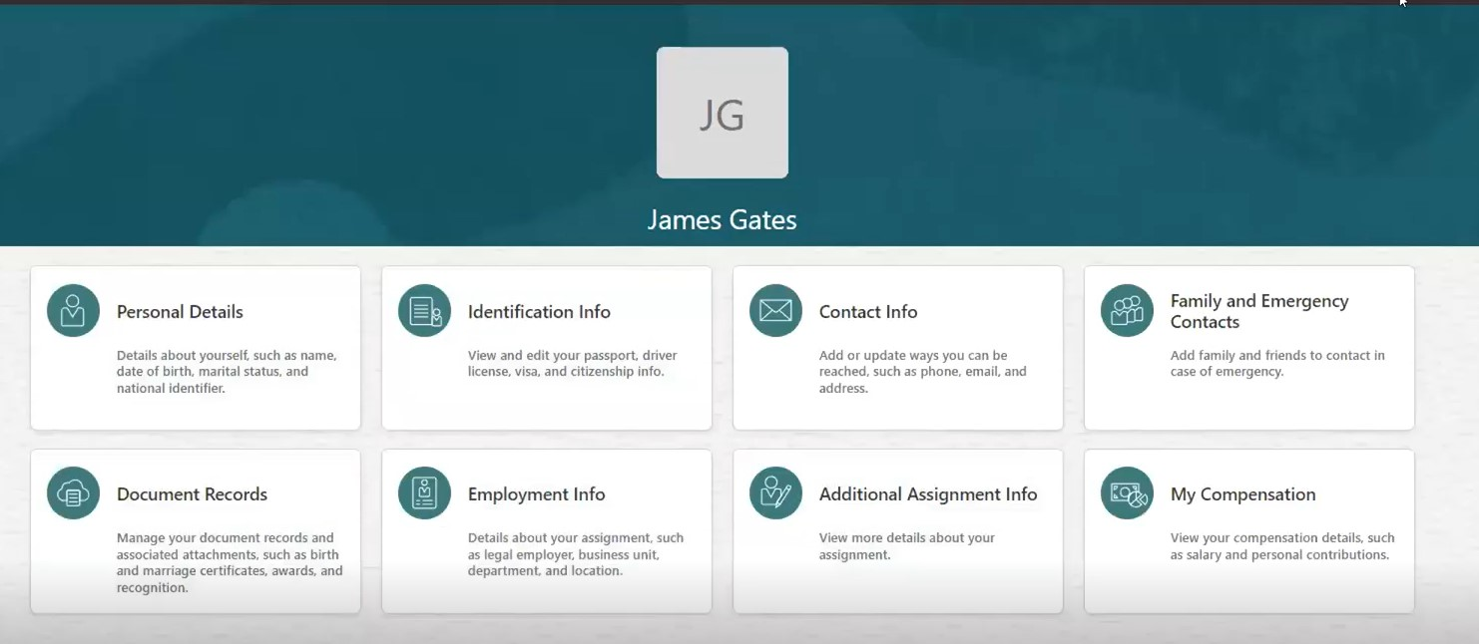
Employee Self-service Tiles

Slide 33
ERP Change Impacts

Slide 34
ERP Change Impacts
 | Future State
Cash Management | All workflows will be new. Oracle allows for Automated reconciliation, NET NEW processes. ONLY impacts central accounting.
Fixed Assets | Ability to upload or manually add, manage, depreciate, and track fixed assets in WolfieONE. Net new processes will require training. Gaining visibility into assets value/depreciation/financial details, automation of data capture and reporting.
Payables (AP) | Leveraging functionality for patient refunds, student refunds, travel reimbursements and department refunds (departments refunding a customer that they billed through AR). Moving to Oracle Cloud. 1099/1042 Reporting and Withholding will be new for SBF and will require training.
Receivables (AR) | New processes will require training: invoicing external clients, balance reconciliation (not done in the current state), creating invoices in ERP, creating and applying receipts, using infolets and watchlists. Decentralized AR model distributes the workload across department (for external invoices) and improves accountability while requiring more unit level training Increased visibility into external billings and better financial reporting Data natively integrated with the General Ledger, enabling the tracking of external receivables, aligning with our Optimized Operations & Processes principle.
General Ledger (GL) | Net new processes will require training. Create, post, review and query journal entries in Oracle Cloud. Entering and posting transactions on time or more frequently is key to having accurate financial statements. The importance of entering/updating data in a timely manner is a key training piece. Moving away from PS Query and NVISION, replacing those reporting tools with ERP seeded reports, OTBI and SmartView tools for financial reporting. New concept: which Business Unit in which to transact and which values to select. Increased coordination and standardized maintenance with HR is paramount, because the org structures are shared.

Slide 35
Personas

Slide 36
Personas (1)
As a Change Champion, it is important for you to know and communicate to your peers:
- Personas can have multiple Oracle Cloud custom roles (your department will be helping DoIT, HR, BFP&A and the Office of the Controller in mapping the right roles to the personas)
- Training (learning pathways) is aligned with personas
/per·so·na/ A fictional character designed to represent a segment of stakeholders who might interact with a process, service or product in a similar way.
Examples of HCM Personas
Manager
Employee
Manage a team
Onboarding support
Generate reports
Evaluate performance
Assign learning content
Fill vacancies
PAIN POINTS: manual paper forms, having to ask DoIT or HR Administrators to perform a transaction for their direct reports
View Personal and Employment information
Complete required training for compliance
Update personal records
View pay slips
Understand performance metrics and access their yearly review
Complete I-9
PAIN POINTS: Having to ask DoIT or their Managers to change their personal data; Manual paper forms (timekeeping, leave requests, disjointed onboarding tasks)

Slide 37
Personas (2)
/per·so·na/ A fictional character designed to represent a segment of stakeholders who might interact with a process, service or product in a similar way.
General Ledger Manager
General Ledger Accountant
Billing Clerk
Review requests for changes to COA ​
Specify cross validation rules or security rules ​
Review/approve journal entries
Approve adjustments and close the period​
Supervise GL Accountants
Oversee changes to policies and to GASB, FASB accounting standards
Business process documentation steward
For SBF: manage external audits and multiple state tax filings
Responsible for 1042 and 1099 reporting
Develop leaders within the team
PAIN POINTS: system limitations, reconciliation issues, process control issues, manual processes, missed month end close deadlines​, spending too much time on finding documentation.
Create Manual journals & Recurring journals​
Upload third party journals
Reconcile unposted entries
Review and create month-end reports​
Process month-end and year-end adjustments​
Perform period-end activities​
Resolve discrepancies or irregularities in records
Account reconciliation within the system and the boundary systems
Ensure financial data is recorded in the appropriate period (accruals, deferrals, prepaids)
Review and post journals
Review/Approve reimbursements (Concur)
PAIN POINTS: Delays in sub-ledger closing and reconciliations​
Spending too much time on finding documentation and chasing people for approvals/sign-offs
Limitations with current system, inconsistent tools
Too many types of journals from various sources
Lack of governance of the chart of accounts.
High volume of cost transfers to balance budgets
Professionals with understanding of billing processes and experience using billing software
Responsible for generation and delivery of invoices to customer, managing the related corrections and reconciling customer payments and invoices
the review of revocable permit contracts received from AP office
Running reports
PAIN POINTS: Not receiving communication on delayed billings and appropriate approvals on correction entries such as credits and adjustments
Lack of time and resources to work with customer to build relationship and collect payments
Incorrect or outdated billing rates for Service Center.

Slide 38
Next Steps

Slide 39
Change Champion Journey Phases
Learn about new functionality and processes. Then, share the benefits using OCM materials to educate peers.​
Design
Build
Test
Train
NOW: Schedule time in your “local” meeting, OR offer to host one.
Send an email to your peers or counterparts introducing yourself and select excerpts from recent eNewsletters to copy onto the email with a note explaining why this is interesting or relevant.
Jan 2025:
HR Changes meeting-in-a-box from OCM team, with a focus on Employee Self Service (ESS) and how Learning (LMS), and Oracle Recruiting Cloud (ORC) will enhance the employee experience.
Feb 2025: Manager Self Service (MSS),
meeting-in-a-box, and how performance management and time and labor will be leveraged by managers.
March 2025:
New COA: with a focus on educating targeted audiences on segment definition, single use for each segment and sharing some relevant examples.
April 2025: Champions to help increase in the number of respondents to the Mid-Point Change Readiness Survey (as compared to the Baseline Readiness Survey - before the launch of the Champion Network)
OCM team delivers a new action plan for the next 3 months.
Fall 2025: Change Champions will gain access to Oracle to familiarize themselves with the interface and prepare to participate in testing.

Slide 40
Next Steps
Review the Champion Toolkit - WolfieONE Champion Website
Identify audiences you would like to share WolfieONE information with. Check with other Champions to ensure there is no duplication of effort.
Check the Events Calendar - https://docs.google.com/spreadsheets/d/e/2PACX-1vRfh3gdssAkKI1wsKb3Yh6eymQI_akkGQIcxxoct6l3473czJrNmJmixn-fPbT0FOQ2b94pFuFqi4pJ/pubhtml
Request time on meetings you can join and add to the Events Calendar using this link - https://docs.google.com/spreadsheets/d/1mFG-WrT48Kv5aorcH1-l67ptlqDkQpP0UKiOjXU0_JE/edit?gid=2023941331#gid=2023941331
Review material to present (will be shared in the Champion Toolkit)
Jan 2025 – Employee Self-Service (ESS)
Feb 2025 – Manager Self-Service (MSS)
March 2025 – COA
The expectations are uniform from all Champions (managers, direct reports)
Communicate with us – we love to hear from our Champions

Slide 41
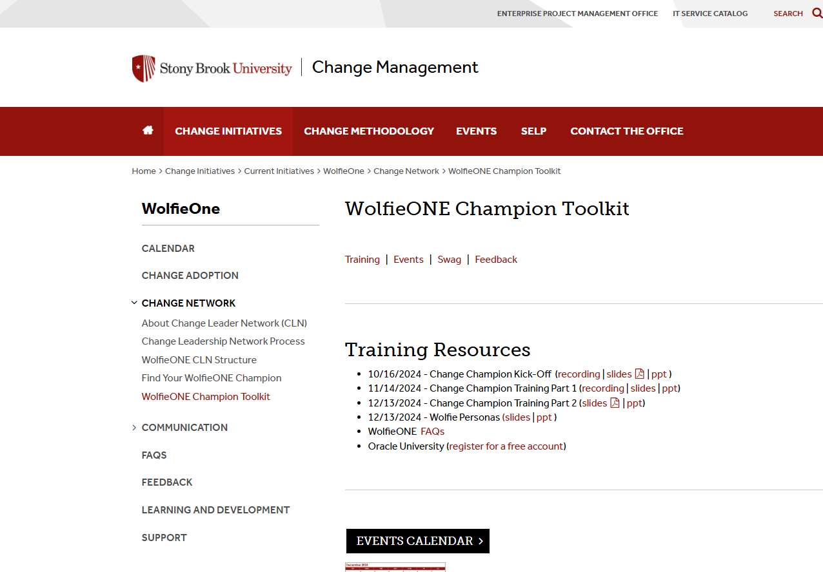
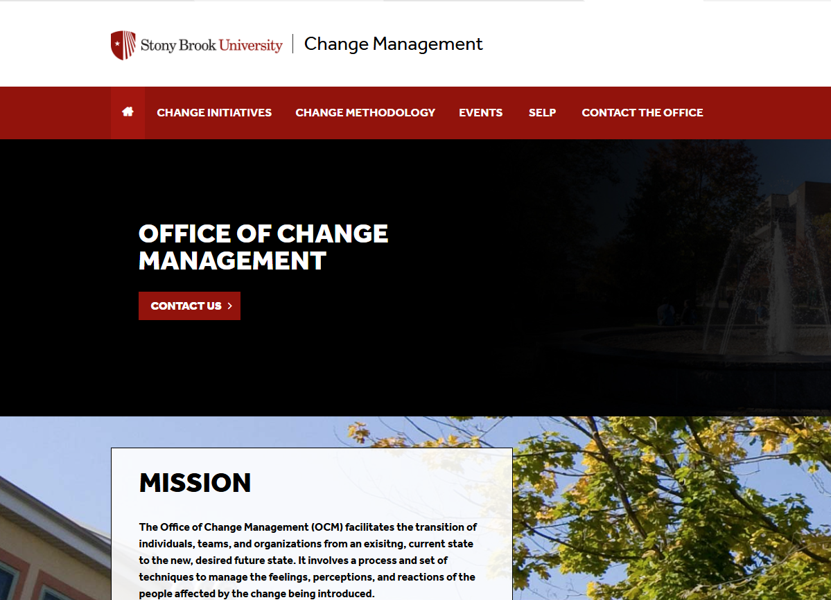
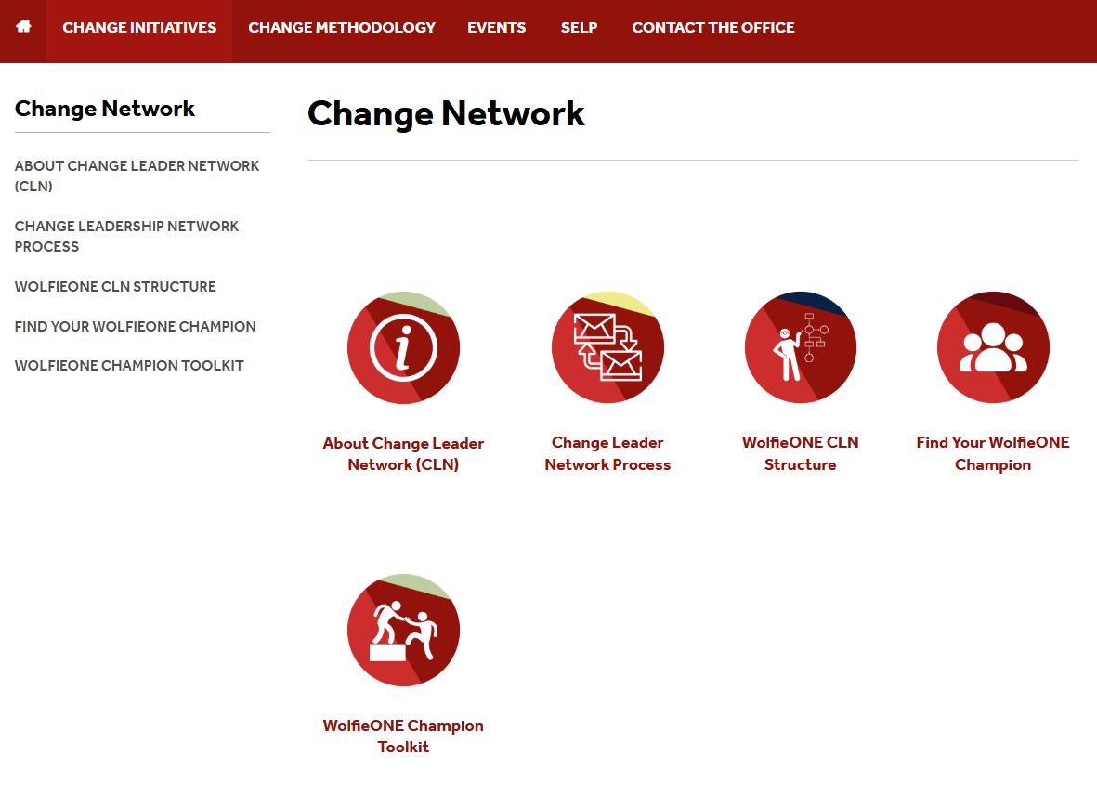
OCM Website:
https://www.stonybrook.edu/commcms/change-management/change_intitiatives/Current_Initiatives/WolfieONE/change_network/WolfieONE_Champion_Toolkit

Slide 42
Appendix

Slide 43
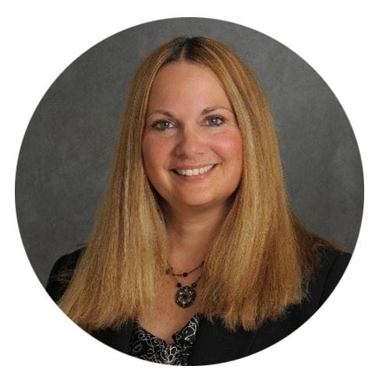
Our Executive Sponsors
Simeon Ananou CIO and VP of the
Division of Information Technology
Carl Lejuez Provost and Executive Vice President
William Wertheim
Interim Executive Vice President for Health Sciences and Stony Brook Medicine
Jed Shivers Senior Vice President for Finance & Administration
Carol Gomes
Chief Executive Officer, Chief Operating Officer, SB Hospital
Dr. Gerald Kelly
Chief Information Officer, SB Hospital

Slide 44
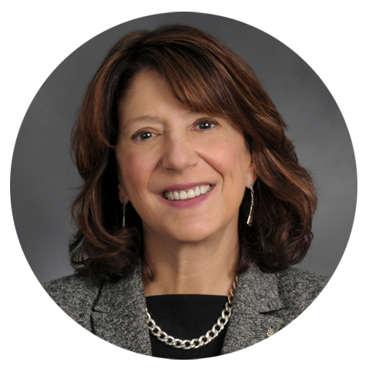
Our Steering Committee
Braden Hosch VP for Educational and Institutional Effectiveness | Cassie Amadio AVP for Accounting and University Controller | Colette Brown Chief HR Officer Stony Brook Medicine | Heather Montague Senior AVP for Budget and Financial Planning | Hina Kausar Director, Office of Change Management
 | John Hennessey Chief Applications Officer, Stony Brook Medicine | Lyle Gomes Vice President for Finance | Tracey McEachern AVP HR Operations, Services, and Payroll | Dennis Gallagher CTO, Medical Information System

Slide 45
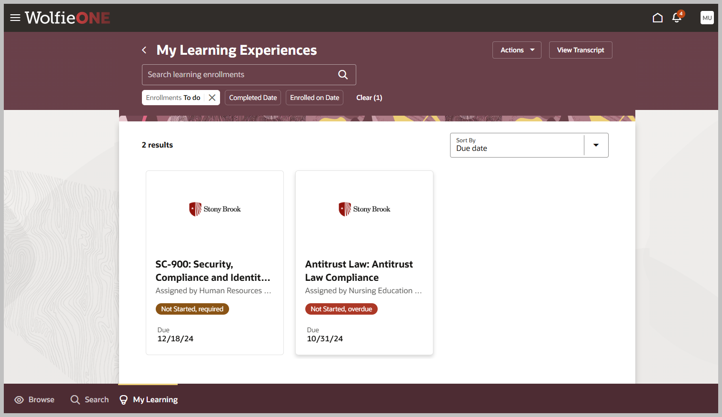
HCM Learning- Screenshot

Slide 46
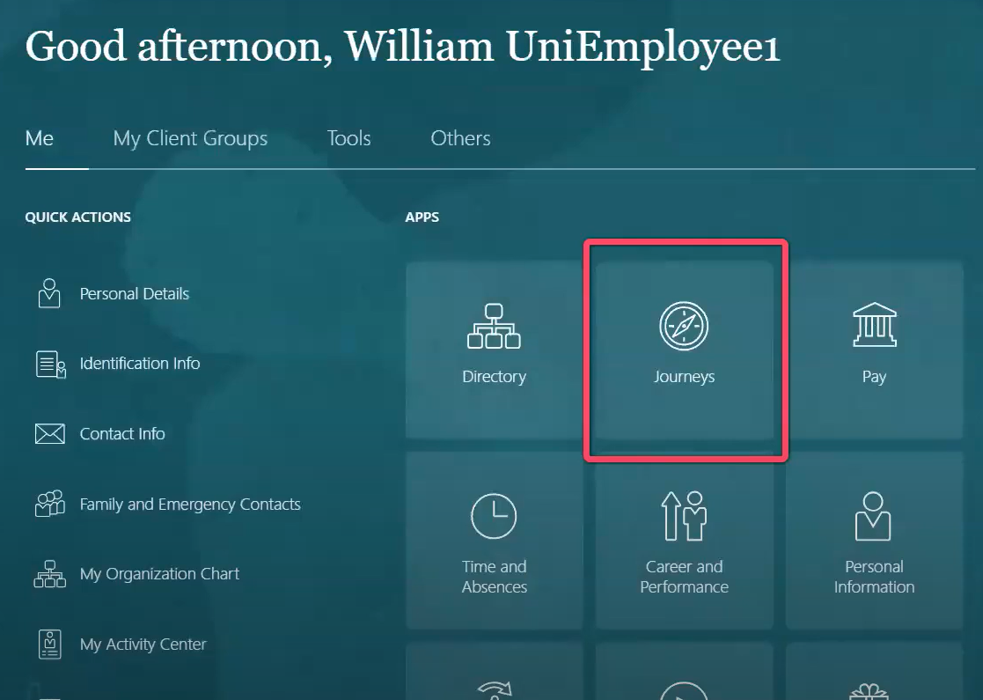
Sample Journeys – Landing Page Tiles

Slide 47
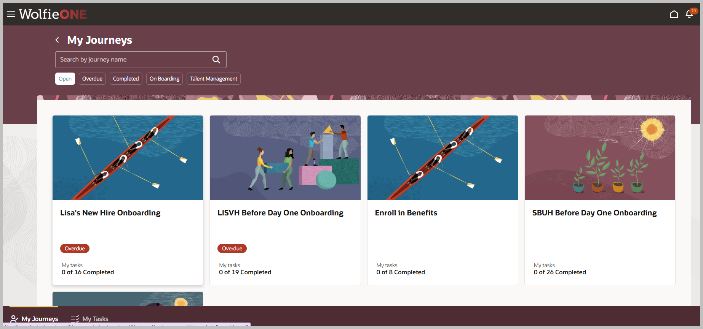
Sample Journeys- HCM Screenshot
We can develop eligibility profiles around Journeys (If I meet that criteria, then the Journey is assigned to me). The Manager can assign journeys, via Manager self-service.

